Slide 1

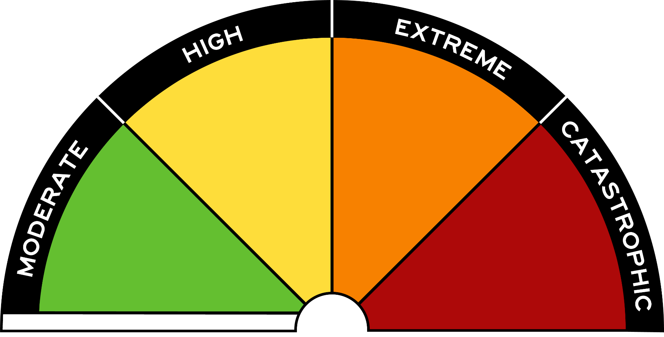
Fire Danger Ratings

Slide 2
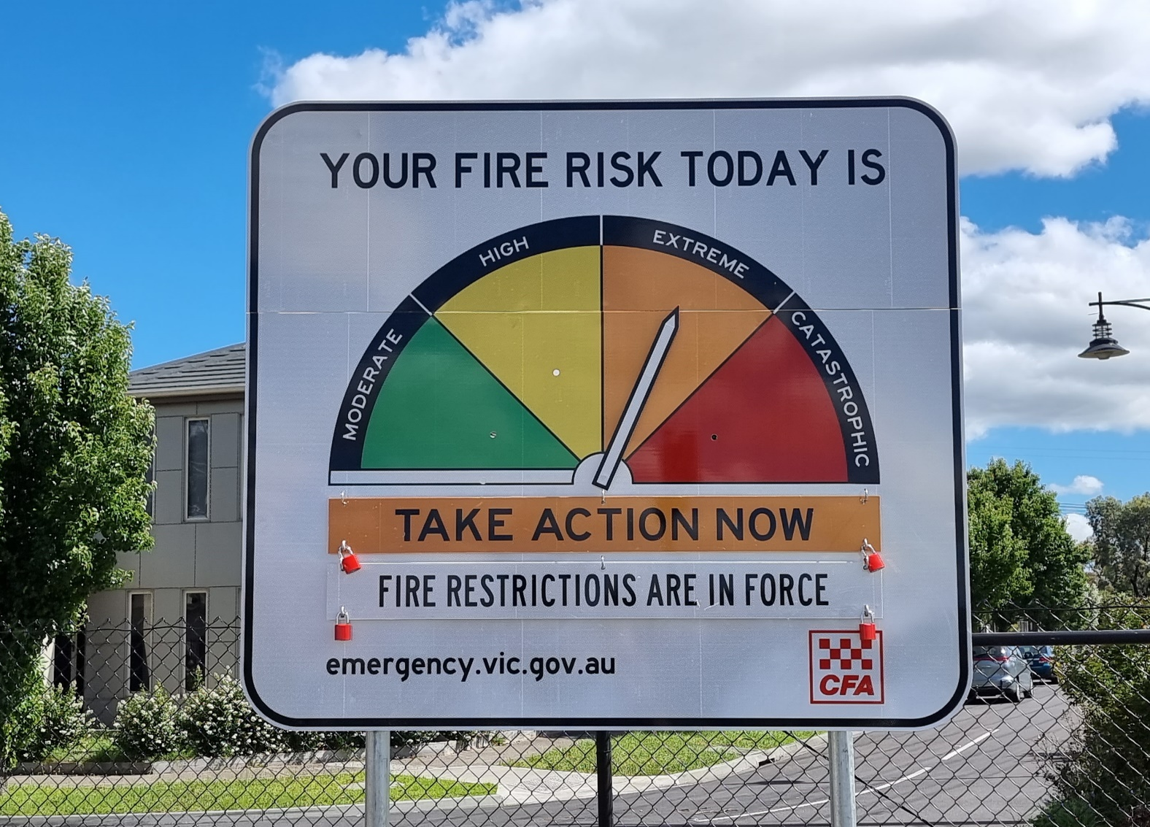
Road signs

Slide 3
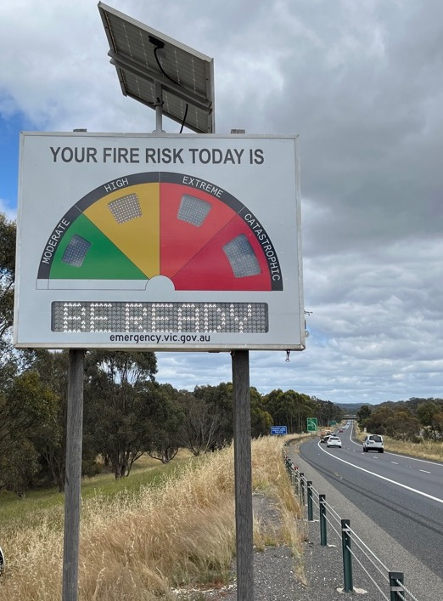
Highway
Notes:
Ask where they may see this sign?
Highways, freeways, before entering a country town, internet or T.V etc.

Slide 4
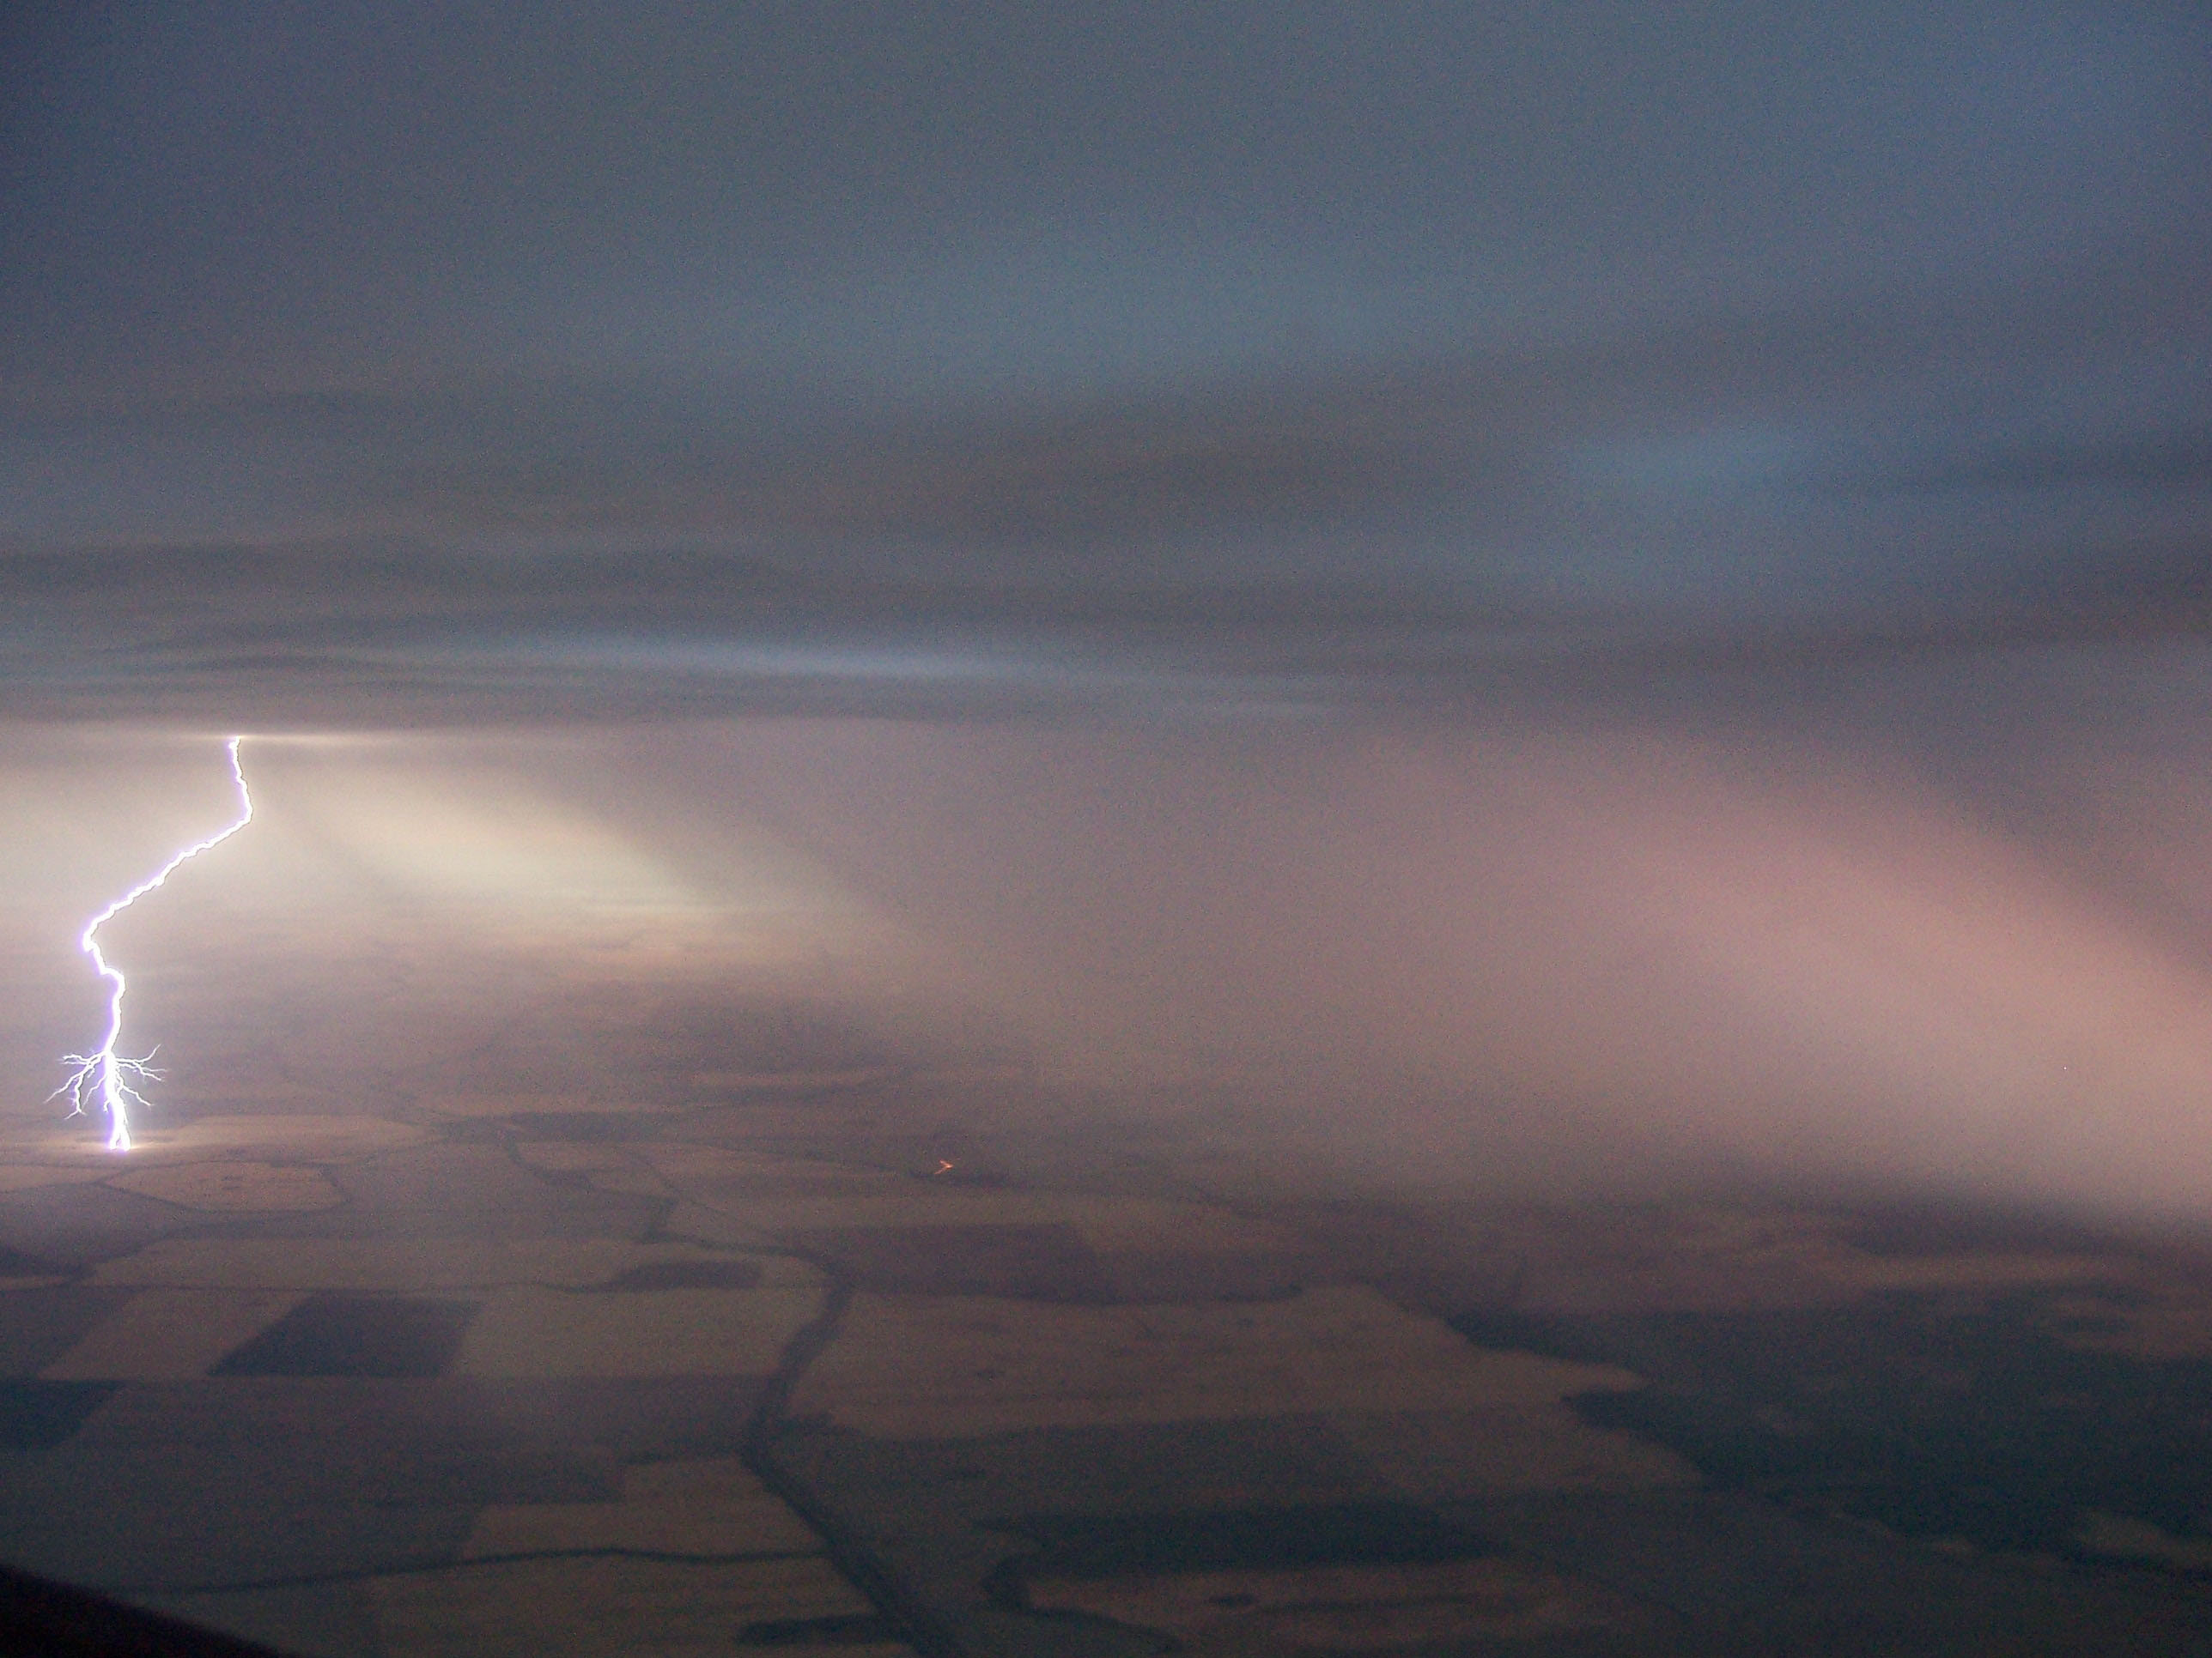
Weather
Notes:
Fires can start by specific weather like lightening, but weather conditions play a major role with how the fire will start and burn.

Slide 5
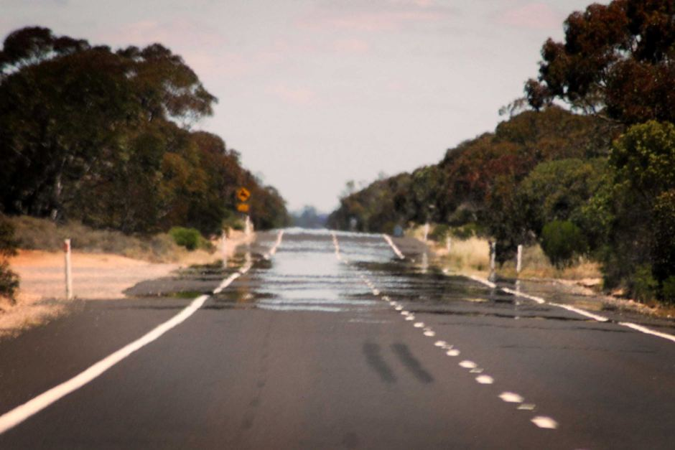
Hot Weather

Slide 6
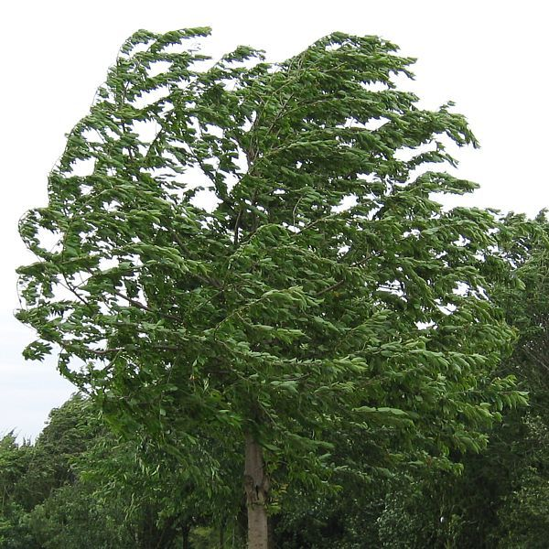
Windy

Slide 7
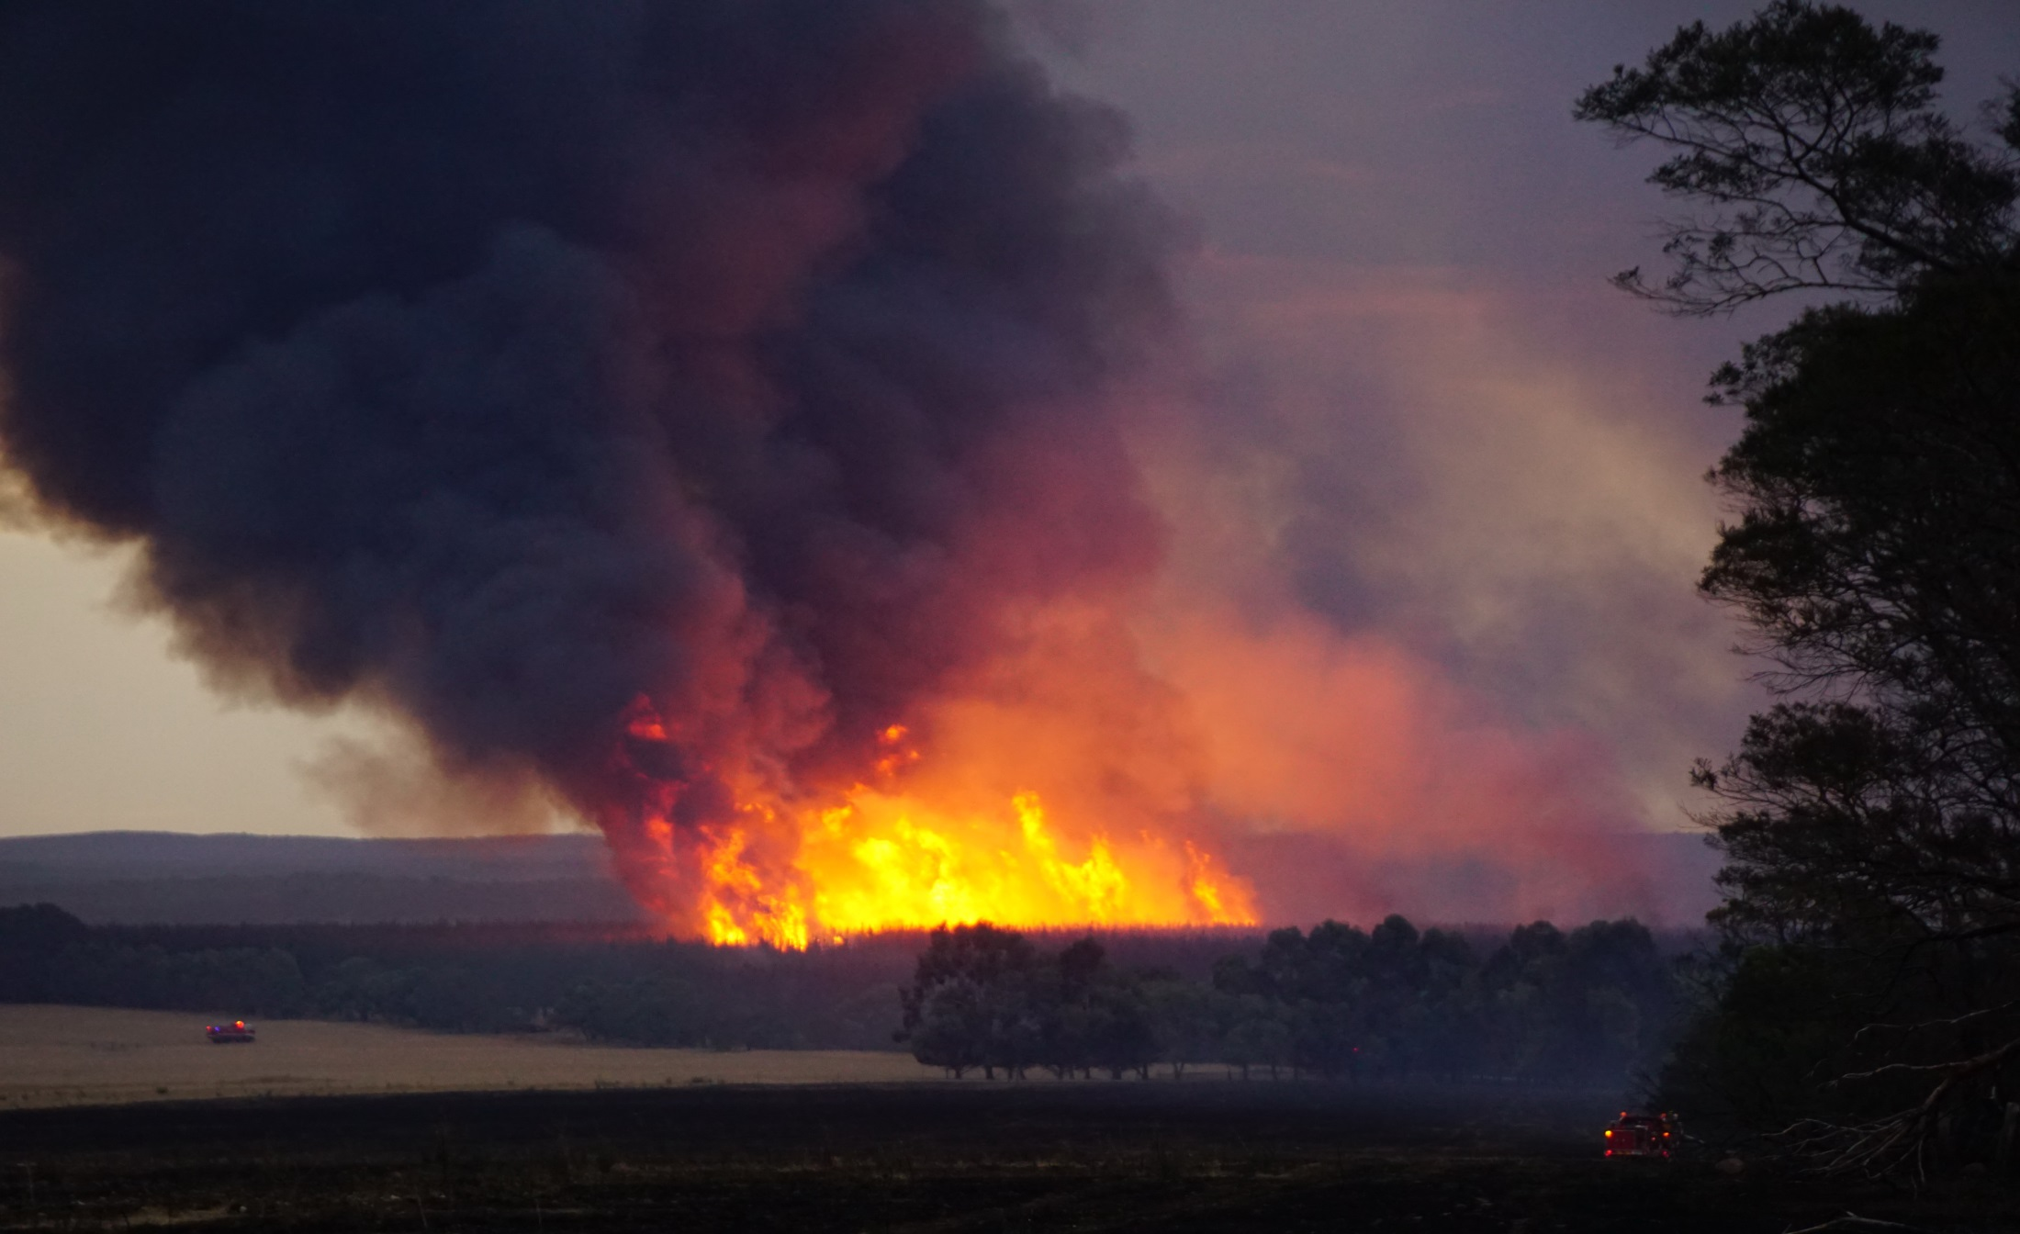
Uncontrollable

Slide 8
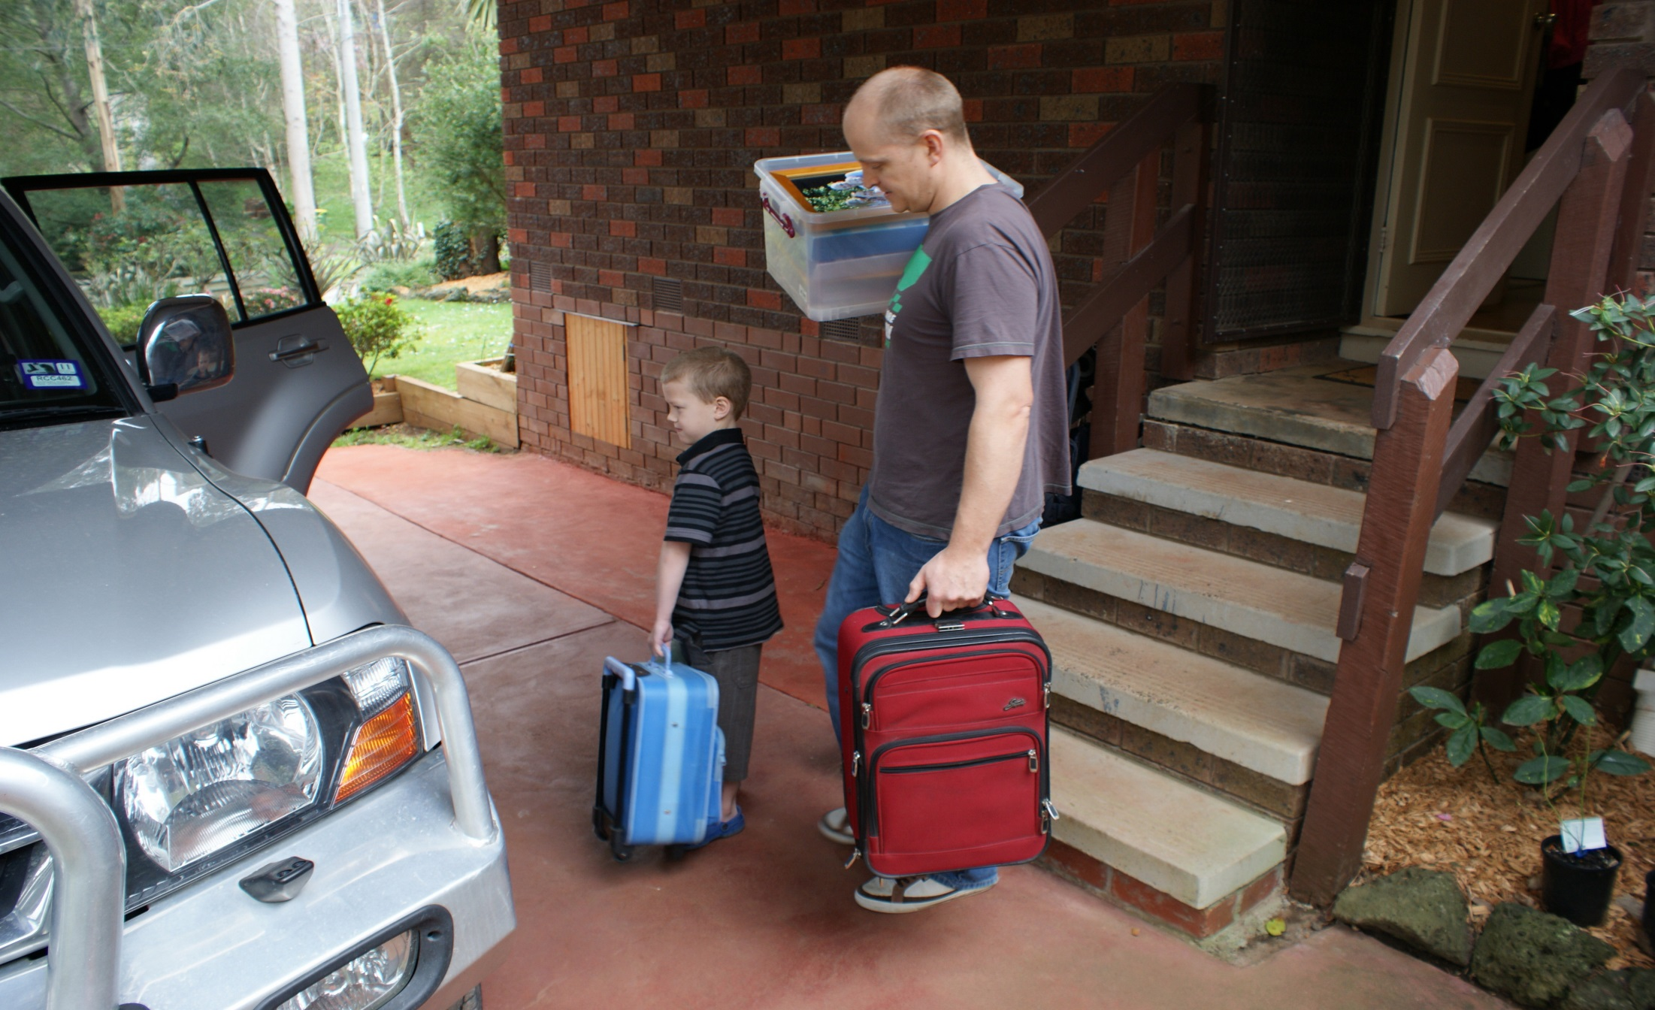
Extreme and Catastrophic

