Slide 1
ABORIGINAL
CULTURAL BURNING
Module 3
Notes:
Dja Dja Wurrung (Djarra) version

Slide 2
Part 1
BEING ON COUNTRY
Notes:
This section could be shortened, covered elsewhere, or explained by a local aboriginal representative.

Slide 3
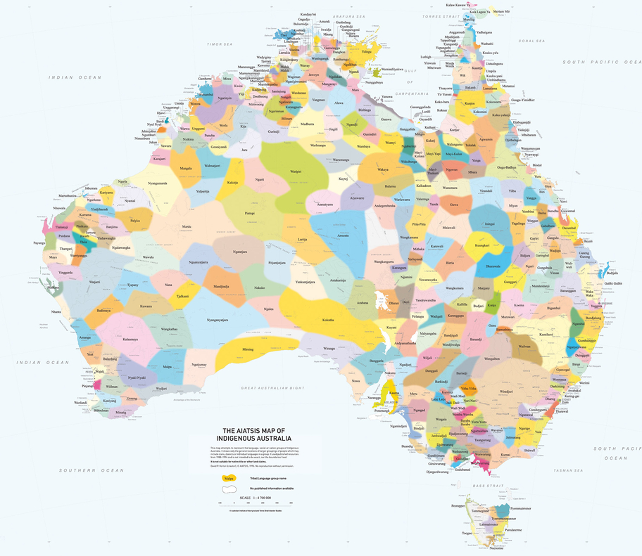
Notes:
Display the AITSIS map and facilitate a class discussion about the AIATSIS Map. Discussion prompts:
Has anybody seen this map before?
What do the different colours and words represent. Aboriginal and Torres Strait Islander Australia is made up of many different groups, each with their own culture, customs, language and laws. This map attempts to represent the nation groups of Indigenous Australia. Each name on the map tells us who the Traditional Custodians of the land are. It tells us whose ‘Country’ we are on. Source: https://aiatsis.gov.au/explore/map-indigenous-australia
What does ‘Country’ mean? Country is the term often used by Aboriginal peoples to describe the lands, waterways and seas to which they are connected. The term contains complex ideas about law, place, custom, language, spiritual belief, cultural practice, material sustenance, family and identity. Source: https://aiatsis.gov.au/explore/welcome-country#toc-what-is-country-
Display the online version of the AIATSIS map on a large screen and show the students how to open it on their laptops. https://aiatsis.gov.au/explore/map-indigenous-Australia. Demonstrate how to zoom in and out and move around the map. Give the students a few minutes to explore the map and familiarise themselves with the zoom function.

Slide 4


Being on Country
What Country is our school located on?
What Country do you live on?
What Country were you born on?
What Country would you most like to visit?
Notes:
Ask the students to write the heading ‘Being on Country’ in their learning journals.
Give the students a few minutes to write their responses the questions on the slide in their learning journal.

Slide 5
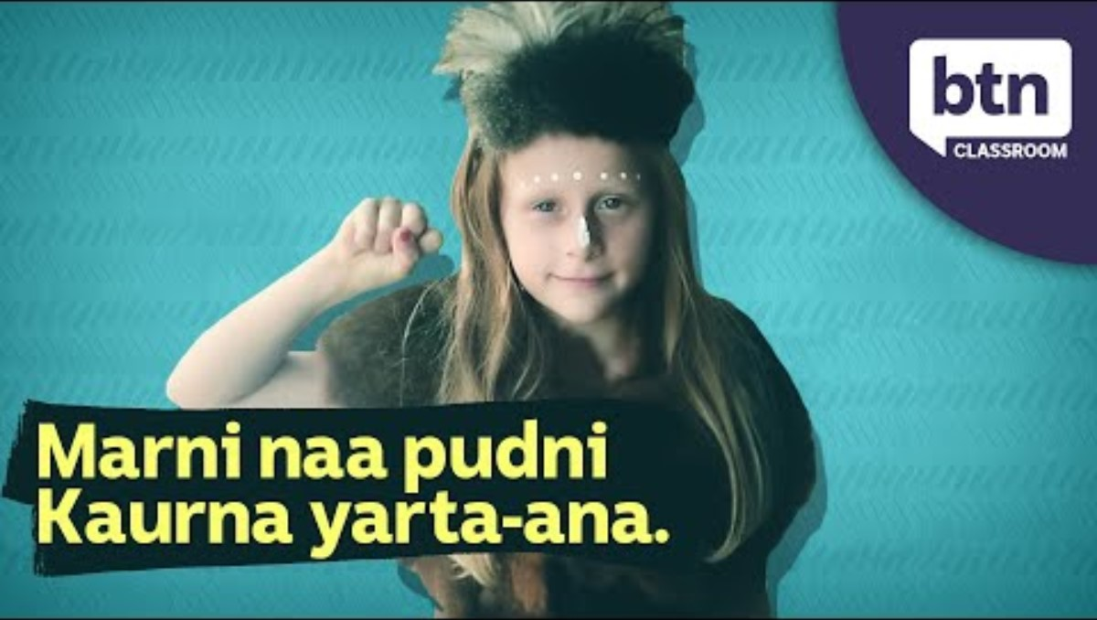
Notes:
Watch the video. Before pressing play tell the students to listen out for the Country that Tiyana is from.
https://www.youtube.com/watch?v=idpod7C-dBs

Slide 6
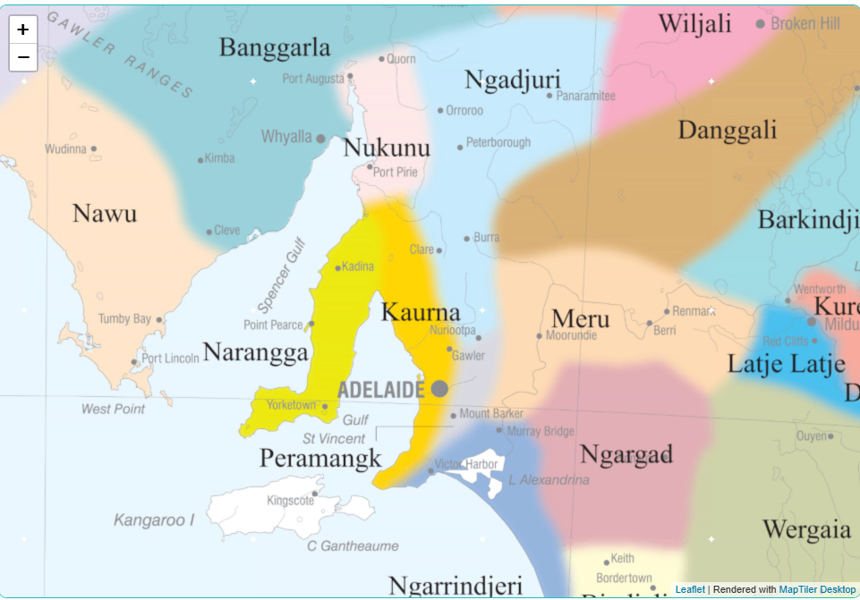
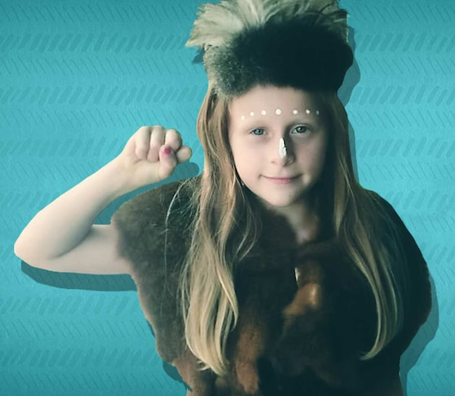
Notes:
Facilitate a discussion about the key concepts in the video. Suggested prompts:
What Country is Tiyana from? Kaurna Country (pronounced ga-na)
What is a Welcome to Country? Welcome to Country has been a part of Indigenous culture for thousands of years. When crossing into another groups Country, you would need to ask permission to enter their land. A Welcome to Country gives you a safe passage and protection during your journey.
Who can give a Welcome to Country? Usually an elder, but sometimes younger people like Tiyana are given permission.
What is an Acknowledgment of Country? It is a way of showing respect for the Traditional Custodians of the land.
Who can give an Acknowledgment of Country? It can be given by both non-Indigenous people and Aboriginal and Torres Strait Islander people.
Ask the students if they have ever seen a Welcome to Country. Encourage them to describe it.
NB: If you are located on Dja Dja Wurrung Country, you may like to watch this video with the students. It features Join Jaara Elder, Uncle Ricky Nelson and Professor Barry Golding who explain the cultural significance of Welcome to Country. https://www.youtube.com/watch?v=ERIkKIORQ98&t=2s
ADDITIONAL TEACHER’S NOTES
A Welcome to Country is delivered by Traditional Owners, or Aboriginal and Torres Strait Islander people who have been given permission from Traditional Owners, to welcome visitors to their Country. It has been a part of Aboriginal and Torres Strait Islander cultures for thousands of years. Before colonization, there were no fences or visible borders, but Aboriginal and Torres Strait Islander groups had clear boundaries separating their Country from that of other groups. Crossing into another group’s Country required a request for permission to enter. When permission was granted the hosting group would welcome the visitors, offering them safe passage and protection during their journey. While visitors were provided with a safe passage, they also had to respect the rules of the land owner group while on their Country. Today, the tradition of welcoming visitors and offering safe passage remain in place. It can take many forms including singing, dancing, smoking ceremonies or a speech in traditional language or English.
An Acknowledgement of Country is an opportunity for anyone to show respect for Traditional Owners and the continuing connection of Aboriginal and Torres Strait Islander peoples to Country.
It can be given by both non-Indigenous people and Aboriginal and Torres Strait Islander people.

Slide 7
Acknowledgment of Country
We acknowledge the _______ people as the Traditional Owners of the land that our school is on and we pay our respects to ________ elders past and present.
Notes:
Ask the students to open a new page in their learning journal and write the heading ‘Acknowledgement of Country’. The students can then write an Acknowledgement of Country using the text on the slide as a guide. If your school already has an Acknowledgment of Country, the students can write that instead.

Slide 8
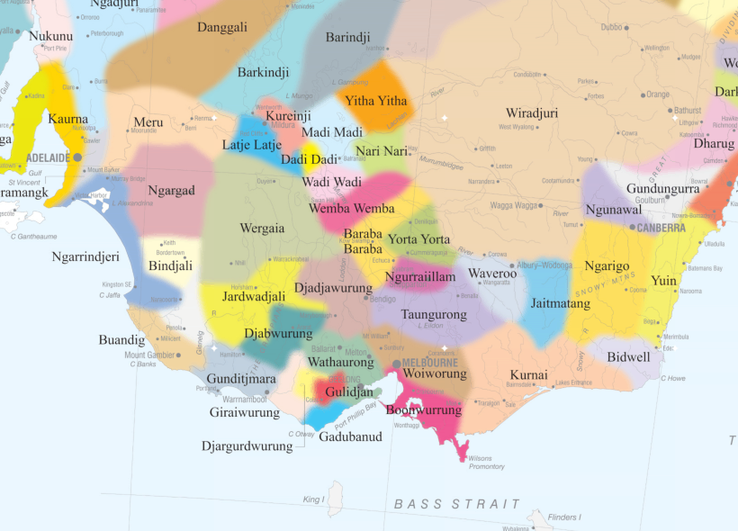
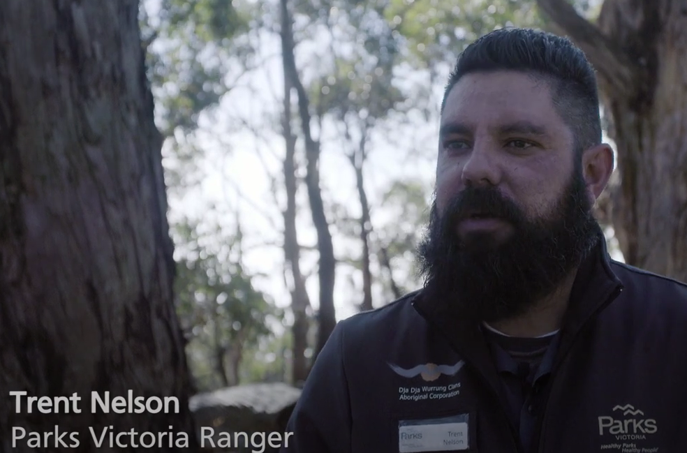
Notes:
Introduce the video ‘Connection to Country: Ranger Trent’. In this video, Dja Dja Wurrung man, Trent Nelson talks about the importance of connecting to and caring for Country.

Slide 9
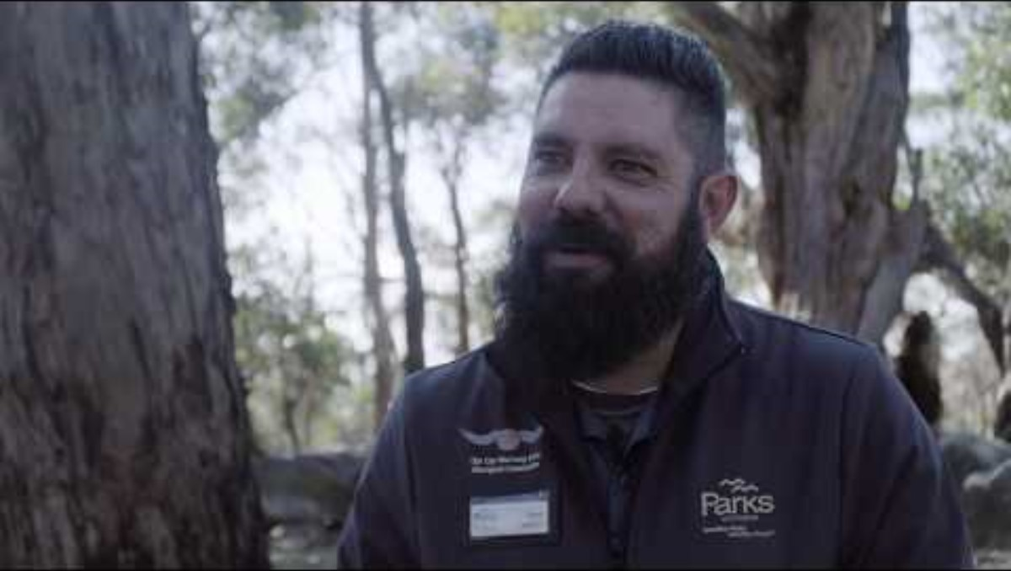
Notes:
Introduce the video ‘Connection to Country: Ranger Trent’. In this video, Dja Dja Wurrung man, Trent Nelson talks about the importance of connecting to and caring for Country.
NB: Video is embedded in the slide. Link to video: https://www.youtube.com/watch?v=DiTW32TEvqQ
Facilitate a discussion about why connecting to and caring for Country is so important to Trent. Suggested prompts:
What is Trent’s connection to Dja Dja Wurrung Country?
How does Trent feel when he is out on Country?
Why is caring for Country so important to Trent?

Slide 10
Caring for Country
One interesting thing I now know is that….
I am still curious about…
One way I could satisfy my curiosity would be to….
Notes:
Ask the students to write the heading Caring for Country in their learning journals and write a short reflection on the video. They can use the sentence stems on the slide as prompts.

Slide 11
Part 2
CARING FOR COUNTRY WITH
CULTURAL BURNING

Slide 12

What do we know about
Aboriginal Cultural Burning?
Notes:
Ask the students if they have ever heard of ‘Aboriginal Cultural Burning’. Facilitate a short discussion about what they already know. Record key points on the board.

Slide 13
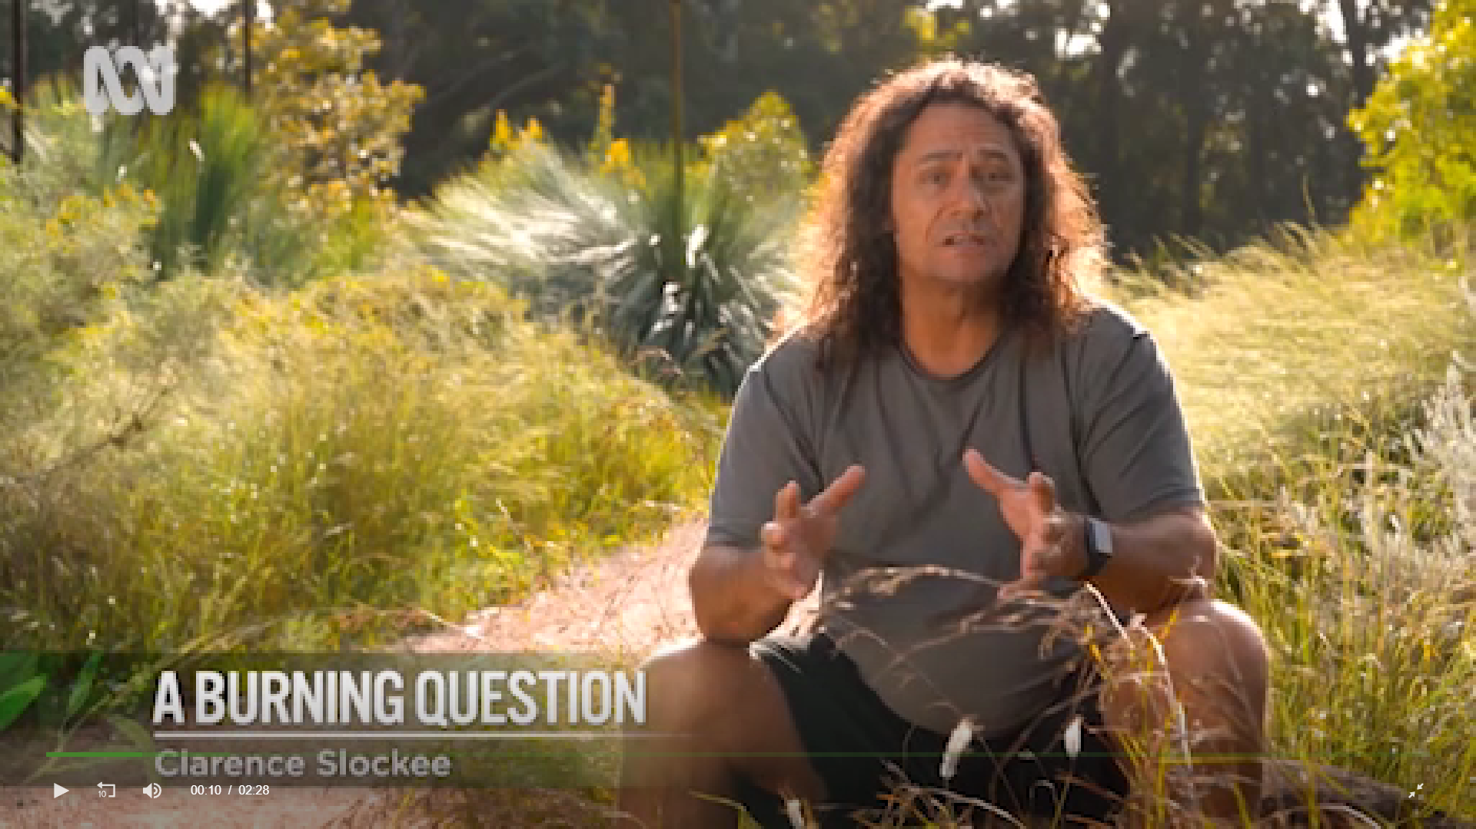
What burning question do you have?
What is the most important point?
What is something you found interesting?
What is something you found difficult to understand?
What burning questions do you have?
Link to video
https://www.abc.net.au/gardening/factsheets/a-burning-question-fire/12395700
Notes:
Provide each student a blank piece of A4 paper. Show them how to fold it into quarters. Instruct them to copy down the questions as shown on the slide.
Tell the students they are going to watch a short video about Aboriginal Cultural Burning and after the video they will respond to the questions on their sheet of paper.
Play the video ‘A Burning Question’. NB: The video cannot be embedded in the slide. Access the video here https://www.abc.net.au/gardening/factsheets/a-burning-question-fire/12395700
Think – Pair- Share: After the video, give the students a few minutes to write their responses to each question. When finished, they can share their responses with the person next to them. Encourage the students to listen actively to each other by tell them that when they have completed their conversations, you will ask some students to explain their partner’s thinking.
Go around the class asking students to share one of the responses from their partner. Encourage the students to listen for similarities and differences to their own responses.
Students can then paste their sheet into their learning journal or write a short reflection on the video using the questions as prompts.

Slide 14
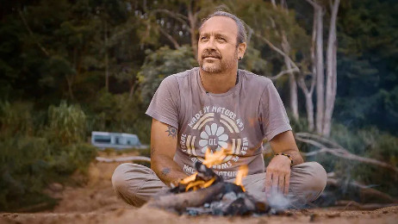
Field Notes - Aboriginal Cultural Burning on
Kuku-Yalanji Country
Notes:
Organise the students into groups of 3 or 4. Tell the students, this will be their ‘research team’.
Tell the students: “You are going on a virtual field trip to Kuku-Yalanji Country in far north Queensland where you will meet Aboriginal cultural burning expert, Victor Steffensen. There are three research questions you need to find answers to on this field trip. You will record the answers in your field notes. NB: The research questions are on the next slide.
Tell the students to open a new page of their learning journal and write the heading ‘Field notes - Aboriginal Cultural Burning on Kuku-Yalanji Country’

Slide 15
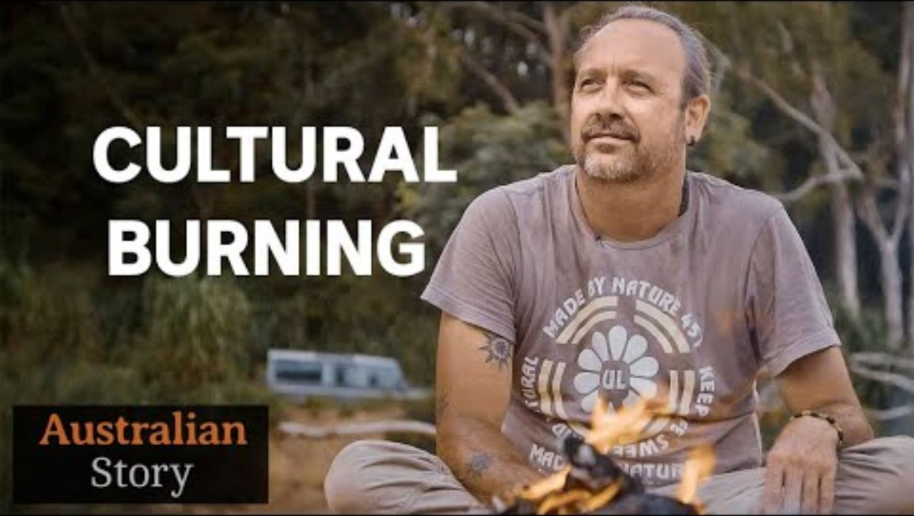
Notes:
Link to video https://www.youtube.com/watch?v=d-9hmEiH828&embeds_referring_euri=https%3A%2F%2Fhubblecontent.osi.office.net%2F&source_ve_path=Mjg2NjY
Play the video in three parts. Before playing each part, write the corresponding research question on the board and ask the students to write it into their learning journal. Tell the students that at the end of each part they will have the chance to discuss their field notes with the other members of their research team and add in anything they might have missed. NB: Advise students that they can record their field notes using both text and drawings.
Part 1: 0:00 - 09.57 Question: How did Victor learn about Cultural Burning?
Part 2: 09.57 - 20:17 Question: Why do Aboriginal people burn Country?
Part 3: 20:17 – Question: What is Victor hoping to achieve?
At the end of the video, invite each research team to share their answers to each research question with the class.

Slide 16
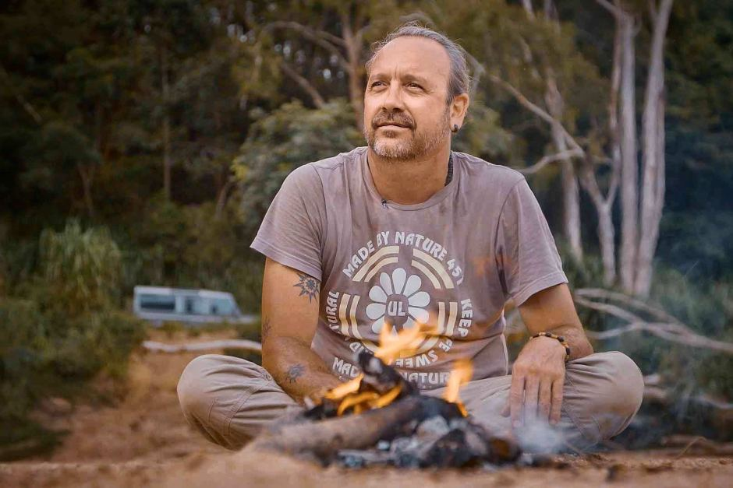
Curious questions
An important skill for any researcher is being able to ask good open-ended questions.
If you had the chance to interview Victor, what questions would you ask him?
Brainstorm open-ended questions for Victor in your research teams.
Write down your top 5 questions in your learning journal.
WHO
WHAT
WHERE
WHEN
WHY
HOW
Notes:
Facilitate a short discussion about the difference between closed and open-ended questions. NB: Closed-ended questions can be answered with yes or no (e.g. Is cultural burning beneficial for plants and animals?). Open-ended questions cannot be answered with a yes or no and require the respondent to elaborate on their points (e.g. What are the benefits of cultural burning for plants and animals?). Open-ended questions usually start with who, what, where, when, why or how.
With the students still in their research teams, allow a few minutes for them to brainstorm open-ended questions for Victor. They can use their field notes for inspiration and record their questions on a large piece of paper. Explicitly instruct the students to be respectful and think carefully about whether Victor would be comfortable answering each question.
Students can then individually select their own top 5 questions from their group list and record them in their learning journals.

Slide 17
Part 3
BRINGING CULTURAL BURNING BACK ONTO COUNTRY

Slide 18
Is Aboriginal cultural burning happening in Victoria?
Notes:
Ask the students if they think Aboriginal cultural burning is happening in Victoria. Facilitate a short discussion to elicit what they already know.

Slide 19
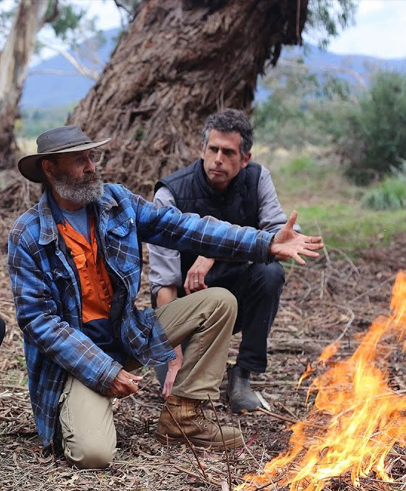
Aboriginal cultural burning on Wurundjeri Country
Uncle Dave Wandin is a Wurundjeri elder. He is bringing cultural burning back to Wurundjeri Country.
Notes:
Tell the students that Aboriginal cultural burning is happening on Wurundjeri Country. Point out Wurundjeri Country on the Map. Introduce Wunrundjeri elder, Uncle Dave Wandin (pictured in check shirt and hat).
Tell the students they are going to watch a video about one of Uncle Dave’s cultural burns on Wurundjeri Country.
NB: The Wurundjeri people are an Aboriginal people of the Woiwurrung language group. For a good explanation of the difference between Wurundjeri and Woiwurrung, watch this video by Wurundjeri woman, Dr Mandy Nicholson https://www.youtube.com/watch?v=HIl8ifFnG7c

Slide 20
What burning question do you have?
See-Hear-Feel-Wonder
WHAT DID YOU SEE?
WHAT DID YOU HEAR?
WHAT DID YOU FEEL?
WHAT DID YOU WONDER?
Notes:
Before playing the video, put the students in groups of 4 or 5. Give each student a piece of A4 paper. Tell the students to fold it into four and then write in the headings as displayed on the slide.
Before playing the video, tell the students that at particular points the video will be paused and they will silently record whatever comes to mind.

Slide 21
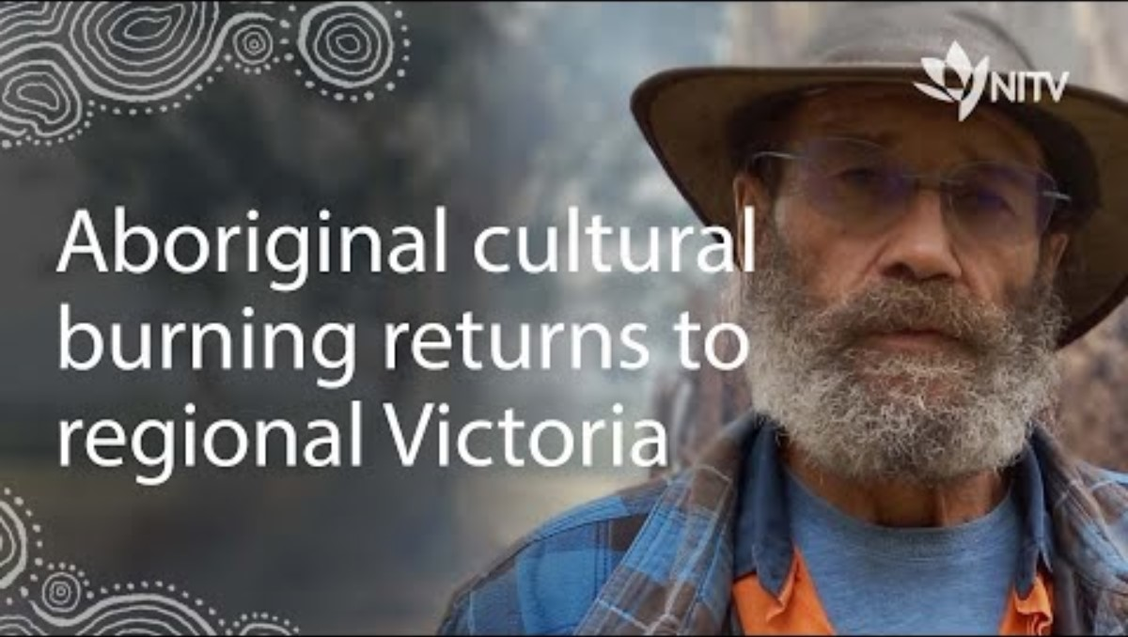
Notes:
NB: The video is embedded in the slide. Link to video: https://www.youtube.com/watch?v=LwL_-JWCn-8
Play the video in four parts. Recommended time stamps are provided below. At the end of each part, give the students a couple of minutes to silently record their responses in each quadrant on their sheet. After a couple of minutes, give the students some time to discuss what they recorded with the other members of their group. They can add any additional information they see as important in the relevant quadrant.
Recommended timestamps
Part 1 00:00 - 01:35
Part 2 01:35 – 03:27
Part 3 03.27 – 04:53
Part 4 04:53 – 05:58

Slide 22
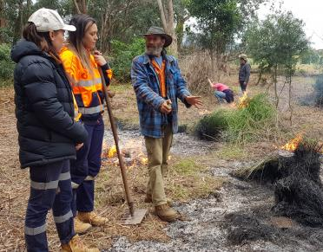
Learning from Uncle Dave Wandin
Create a text about what you have learned from Uncle Dave.
You can use pen and paper, voice recording, video, drawing, PowerPoint, poster, or any combination of these.
Use the information you recorded on your See-Hear-Feel-Wonder worksheet for inspiration and ideas.
Notes:
Think-Pair-Share: Give the students a minute or two to think about the most important things they have learned about Aboriginal Cultural Burning from Uncle Dave. The students can then discuss their ideas with a partner. Invite the students to share their partner’s thoughts and record them on the board. Highlight any key themes as they emerge e.g. the benefits of cultural burning (environmental, social, cultural, psychological, spiritual), when to burn, how to burn etc.
Talk through the task instructions on the slide. Remind the students that they can use their See-Hear-Feel-Wonder worksheet for inspiration and ideas.

Slide 23
End of Module

