Slide 1
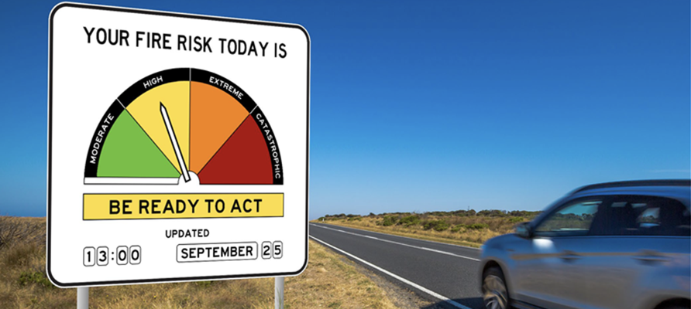
Module 5
BUSHFIRE RISK

Slide 2
Part 1
BUSHFIRE HAZARDS AND THEIR IMPACTS

Slide 3

In Victoria, fire is an important part of the environment. Many plant and animal species depend on fire for their survival and Aboriginal people use fire to care for Country. However, fire can also be a natural hazard.
What is a natural hazard?
Notes:
Present the information in the green box on the slide. You may want take this importunity to review some of the key learnings from the Fire Ecology module and the Aboriginal Cultural Burning module.
THINK – PAIR – SHARE. What is a natural hazard?
Invite some of the students to share their partner’s response.

Slide 4

Can bushfires cause damage and harm to communities and environments?
A natural hazard is a natural process that can cause damage and harm to communities and environments.
Notes:
Present the definition of ‘natural hazard.
Facilitate a class discussion about whether bushfire can damage and harm to communities and environments. Ask the students to provide some examples of the damage and harm bushfires can cause to communities (e.g. house burn down) and environments (e.g. wildlife are injured).

Slide 5
?
?
?
?
?
?
BUSHFIRE HAZARD
IMPACTS
?
?
?
?
?
The focus question for our concept map is:
What harmful impacts can bushfires have on
communities and environments?
REMEMBER…
Talking about the impacts of bushfire hazards can be scary and stressful for people, so you need to be SENSIBLE and be SENSITIVE to other people’s feelings.
Notes:
Post a large sheet of paper up on the wall. In the centre, draw a circle and label it ‘Bushfire Hazard Impacts’.
Tell the students: We are going to create concept map of bushfire hazard impacts. The focus question for the concept map is ‘What harmful impacts can bushfires have on communities and environments?
Before you begin, emphasise to the class that talking about the impacts of bushfire hazards can be scary and stressful for people, so you need to be SENSIBLE and be SENSITIVE to other people’s feelings.
Go around the class, asking student to contribute their ideas. Encourage the students to build on the ideas of others (e.g. houses burn down > people lose their homes > people have to move to another town > people miss their friends).

Slide 6

Look at the different hazard impacts on
our concept map.
Which three hazard impacts concern you the most? Why?
Go up to the concept map and draw a small dot next to each of the three hazard impacts that concern you the most.
Notes:
THINK -PAIR- SHARE Which three hazard impacts concern you the most? Why?
After the think-pair-share, ask the students to go up to the concept map and draw a small dot next to the three hazard impacts that concern them the most. They can do this in small groups.

Slide 7

Look at the dots on our hazard impacts concept map.
Which hazard impacts are we most concerned about?
Is there anything people can do to prevent or minimise these hazard impacts?
Notes:
Tell the students to look at the dots on the concept map. Ask them, ‘Which hazard impacts are the students in our class concerned about?’
Ask the students: Is there anything people can do to prevent or minimise these hazard impacts? Select some of the hazard impacts with the most dots and ask the class to brainstorm the things people can do to prevent or minimise those impacts.

Slide 8
Do you think our class could do anything to prevent or minimise the impacts of bushfire hazards on our community?
Notes:
Ask the students: Could our class do anything to prevent or minimise the impacts of bushfire hazard in our own community?
Facilitate a short discussion about what they might be able to do.

Slide 9
YOU HAVE
KNOWLEDGE
You have learned a lot about bushfires – from fire ecology to Aboriginal cultural burning to bushfire behaviour. You also have a lot of very important local knowledge about the people and places in your community.
YOU HAVE PERSONAL STRENGTHS AND SKILLS
You might be determined, persistent, courageous, imaginative or empathetic. You might be good at interviewing, drawing, film-making, gardening, acting, storytelling, video game design or public speaking.
YOU HAVE
RESOURCES
You have access to all sorts of equipment - computers, art materials, video cameras and more! You also have people who can help you, including your teachers, parents, and other people in the local community.
We can use our collective knowledge, personal strengths, skills and resources to take effective action!
Notes:
Present the information on the slide.
Ask the students to recall the story of Tilly Smith and then facilitate a discussion about the knowledge, skills and resources that Tilly used to prevent tsunami impacts. Suggested prompts:
Did Tilly have knowledge that she could use to take effective action? She knew the early warns signs of the tsunami – the water was all frothy like you get on a beer
Did Tilly have personal strengths or skills she could use to take effective action? She was very determined. She didn’t give up.
Did Tilly have access to resources that could she could use to take effective action? The security guard was able to help her.
NB: You may like to present the information on the slide and then watch the film about Tilly again. Before pressing play, ask the students to pay attention to the knowledge, skills and resources that Tilly used to take effective action.
Link to video https://www.youtube.com/watch?v=V0s2i7Cc7wA

Slide 10
Part 2
BUSHFIRE PRONE AREAS

Slide 11
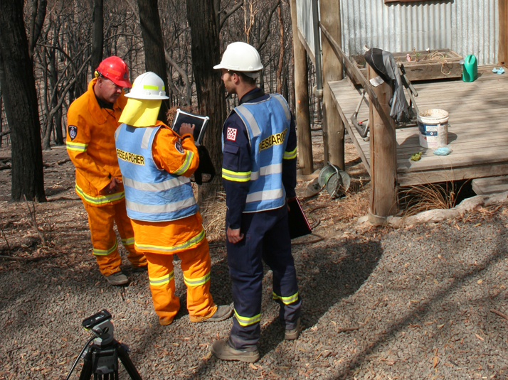
After every major bushfire in Victoria, bushfire scientists have gone into the fire affected area to assess the impacts on communities and the environment. They have also been able to identify some of the problems that make communities and environments more vulnerable to those impacts.
We are going to learn about some of problems that have been identified by the bushfire scientists…And you are going to try and come up with some solutions!

Slide 12
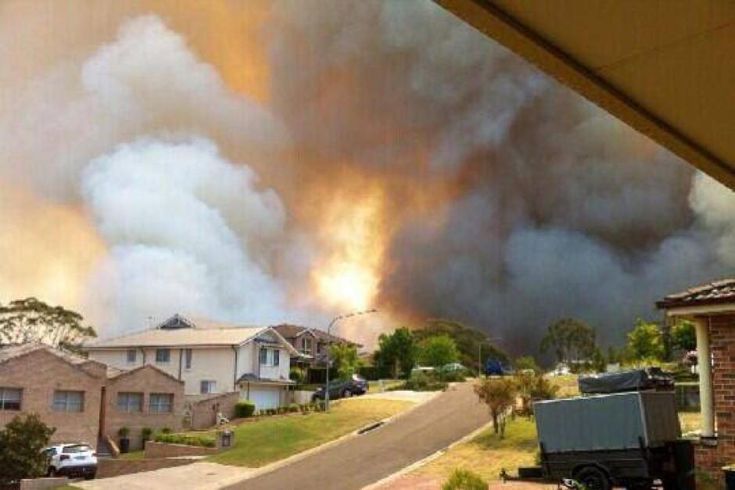

THE PROBLEM
People don’t know that they live in bushfire prone area that could be impacted by bushfire hazards.
“People might look around and say ‘Bushfire is something that happens out there in the bush, not here in the suburbs’. But as we've seen, embers can carry fire right into suburban environments and bring fire to people who might not be prepared for it”
- Dr Josh Whittaker, Bushfire Scientist
How can people find out if their house is in a location that could be impacted by bushfire hazards?
Notes:
Present the problem: People don’t know that they live in bushfire prone area that could be impacted by bushfire hazards.
Put the students into groups of four. Give them a few minutes to discuss the question: How can people find out if their house is in a location that could be impacted by bushfire hazards?
Ask the groups to nominate a spokesperson. Ask the spokesperson from each group to share their groups ideas with the class.

Slide 13
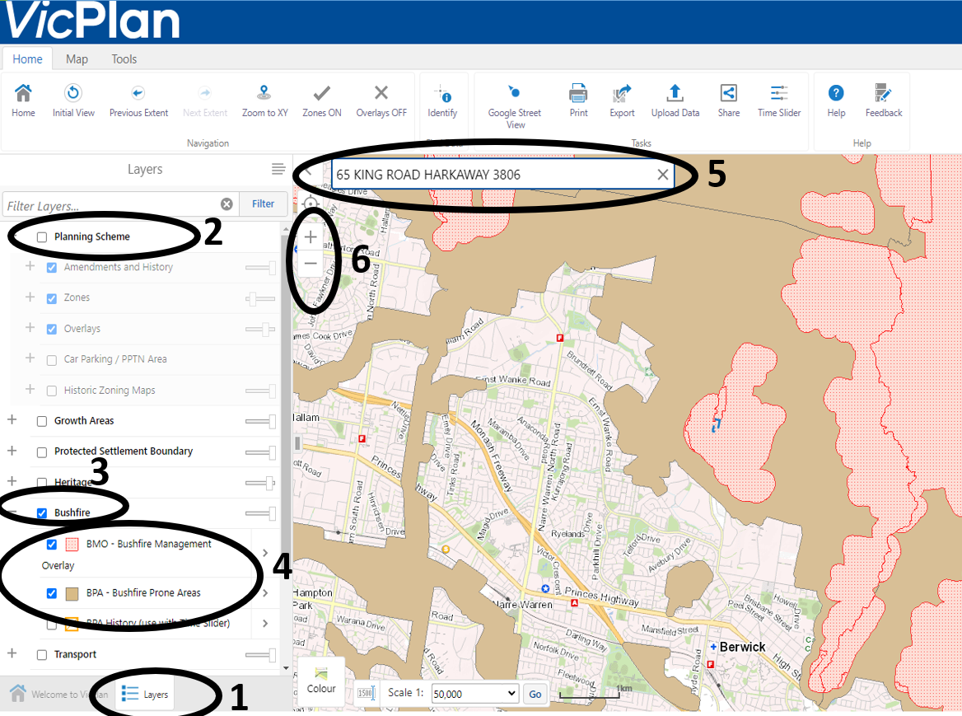
The online VicPlan map tells us which locations are bushfire prone and could be impacted by bushfire hazards.
Open VicPlan on your laptop
https://mapshare.vic.gov.au/vicplan/
Press I agree
1. Click on Layers
Untick Planning Scheme
Tick Bushfire
Tick BMO-Bushfire Management Overlay and BPA-Bushfire Prone Areas
Type in the address of our school
Use the + - to zoom out to see our local area
Notes:
Tell the students that the online VicPlan map tells us which locations are bushfire prone and could be impacted by bushfire hazards.
Ask the student to open their laptops and work through the instructions on the slide.
NB: You may want to display each step in the process on a large screen.

Slide 14
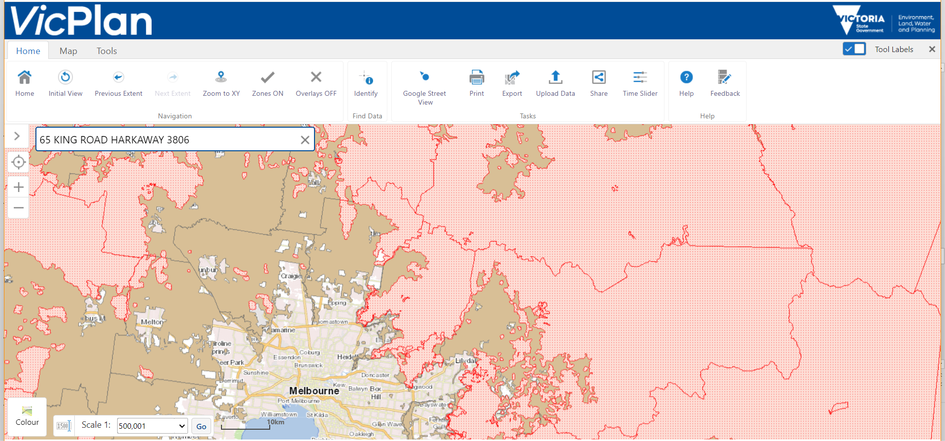
BUSHFIRE MANAGEMENT OVERLAY (BMO)
The red areas on the map indicate bushfire prone areas that have extreme fuel loads.
In these areas, there is the potential for high intensity crown fires that create large amounts of radiant heat and lots of embers.
BUSHFIRE PRONE AREA (BPA)
The light brown areas on the map indicate places where a bushfire could occur.
Most of Victoria is a Bushfire Prone Area.
Notes:
Present the slide and explain that the brown areas are BUSHFIRE PRONE AREA (BPA) and the red areas are BUSHFIRE MANAGEMENT OVERLAY.
Ask the students: Is our school located in a bushfire prone area or in the Bushfire Management Overlay?
Give the students a few minutes to enter other addresses into address bar and determine whether they are in the BPA or the BMO? E.g. their own home address, the local shopping centre, the homes of friends or relatives.

Slide 15
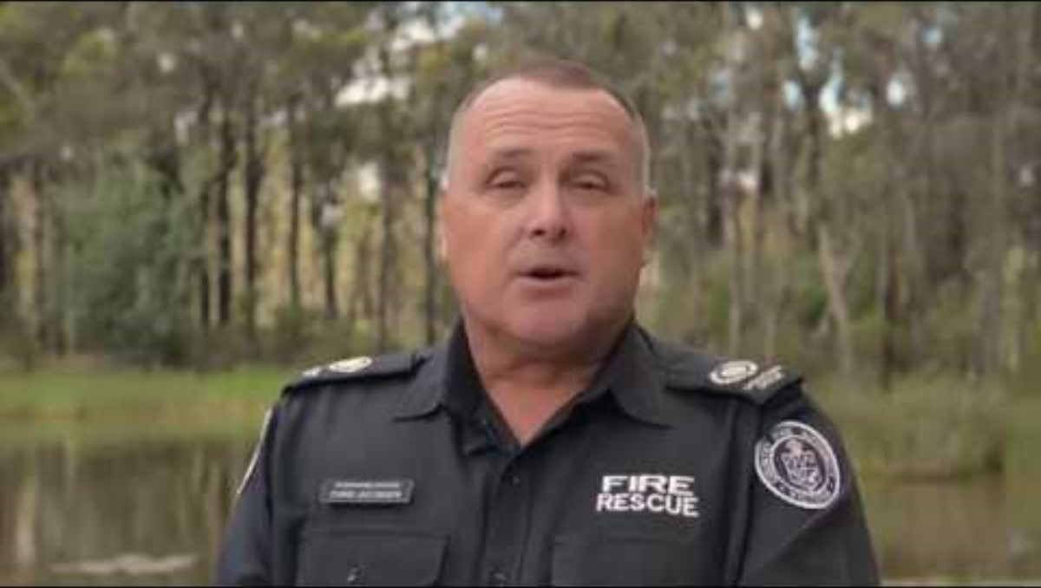
Notes:
Watch the video about the bushfire management overlay. Before pressing play, tell the students to listen out for the things that people in BMO need to do to stay safe.

Slide 16
Does everyone in our community know if their house is in a location that could be impacted bushfire hazards?
Notes:
Ask the students to discuss the following question in their groups: Does everyone in our community know if their house is located in a place that could be impacted bushfire hazards? Encourage the students to explain their thinking to their fellow group members.
Ask each group to nominate a spokesperson to share their groups response to the question.
Ask the whole class: Is this a problem? Why/Why not?

Slide 17

TEAM CHALLENGE!
The bushfire season is approaching. The local CFA is concerned that people in our community don't know if their house is in a location that could be impacted bushfire hazards.
How can we make sure that everyone in our community knows if their property could be impacted by bushfire hazards?
Your team has 3 minutes to come up with one great idea that makes the most of your knowledge, strengths skills, and resources!
Image: Kealey, Harkaway Primary School, Class of 2021.
Notes:
Organise the students in teams of 4 or 5.
Introduce the problem: The bushfire season is approaching. The local CFA is very concerned that some people in our community don’t know if their property is located could be impacted by bushfire hazards.
Ask the students “Why is this a problem?” e.g. If people don’t know that their property could impacted by bushfire hazards, they might not do anything to prepare and their property could be damaged.
Present the question: “How can we make sure that everyone in our community knows if their property could be impacted by bushfire hazards?”
Give the students three minutes to come up with one great idea that makes the most of their knowledge, strengths, skills and resources. A spokesperson from each group can then share their idea with the class.
The students can then record the problem, the ‘How can we…?’ question and their idea in their learning journal.

Slide 18
Part 3
PROPERTY PREPARATION

Slide 19
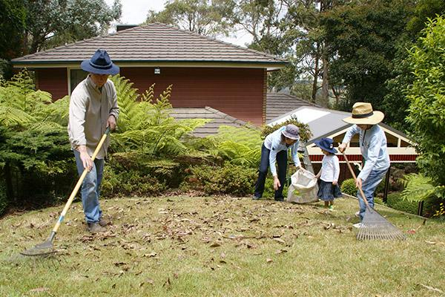
THE PROBLEM
People don’t do everything they can to prepare their
property for bushfire season.
Lots of people do simple and easy things to prepare their property, such as clearing up leaves and mowing the lawn. That’s a great start, but there is a lot more people can do to prepare their property for bushfire season.
Why don’t people do everything they can to
prepare their property for bushfire season?
Notes:
Present the problem: People don’t do everything they can to prepare their property for bushfire season.
Put the student into groups of four. Give them a few minutes to discuss the question: Why don’t people do everything they can to prepare their property for bushfire season?
Ask the groups to nominate a spokesperson. Ask the spokesperson from each group to share their groups ideas with the class.

Slide 20
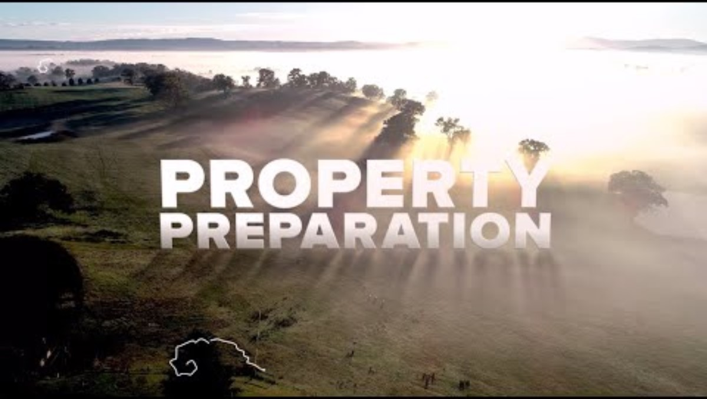
Notes:
Tell the students they are going to a video about property preparation. Before pressing play tell the students to note down as many preparedness actions as they can.
Play the video.
After the video is finished, used the students to notes to make a class list of preparedness actions. Students can write this list into their learning journals.
ADDITIONAL VIDEOS ABOUT PROPERTY PREPARATION:
Garden design for bushfire (Country Fire Authority) https://www.youtube.com/watch?v=UJi3XbN5aQk
How to prepare your home for bushfire season | Big Weather (ABC TV) https://www.youtube.com/watch?v=y1wzsm7NSJs

Slide 21
Do you think everyone in our community is doing everything they can to prepare their property for bushfire season?
Notes:
Ask the students to discuss the question in their groups: Does everyone in our community know if their house is located in a place that could be impacted bushfire hazards? Encourage the students to explain their thinking to their fellow group members.
Ask each group to nominate a spokesperson to share their groups response to the question.
Ask the whole class: Is this a problem? Why/Why not?

Slide 22
TEAM CHALLENGE
The bushfire season is approaching. The local CFA is concerned that people in our community are not doing everything they can to prepare their property for bushfire season.
How can we encourage people in our community do everything they can to prepare their property for bushfire season?
Your team has 3 minutes to come up with one great idea that makes the most of your knowledge, skills and resources!
Image: Kealey, Harkaway Primary School, Class of 2021.
Notes:
Organise the students in teams of 4 or 5.
Introduce the problem: The bushfire season is approaching. The local CFA is concerned that people in our community are not doing everything they can to prepare their property for bushfire season.
Ask the students “Why is this a problem?”
Present the question: “How can we encourage people in our community do everything they can to prepare their property for bushfire season?”
Give the students three minutes to come up with one great idea that makes the most of their knowledge, strengths, skills and resources. A spokesperson from each group can then share their idea with the class.
The students can then record the problem, the ‘How can we…?’ question and their idea in their learning journal.

Slide 23
Part 4
FIRE DANGER RATINGS

Slide 24
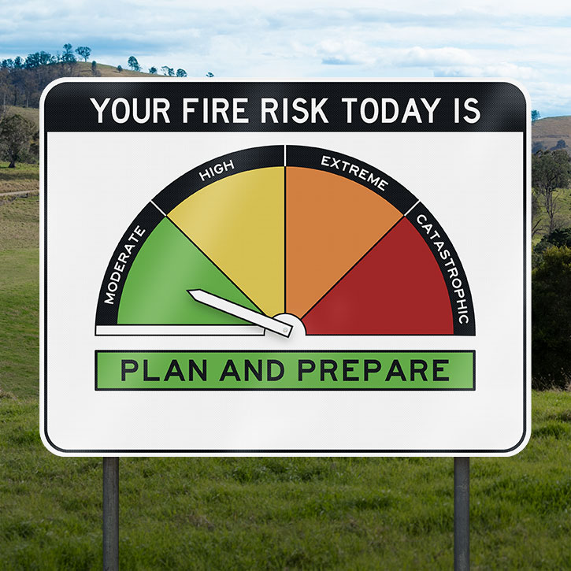
THE PROBLEM
The Fire Danger Rating System provides really important information that people can use to stay safe from bushfires, but a lot of people don’t know how to use it.
What do you know about the Australian Fire Danger Rating System?
Notes:
Ask the students: Have you ever seen the sign in this photo? Ask them follow up questions about where and when.
Tell the students: This sign is for the Australian Fire Danger Rating System.
Present the problem: The Fire Danger Rating System provides really important information that people can use to stay safe from bushfires, but a lot of people don’t know how to use it.
Think – Pair – Share: What do you know about the fire danger rating system?

Slide 25
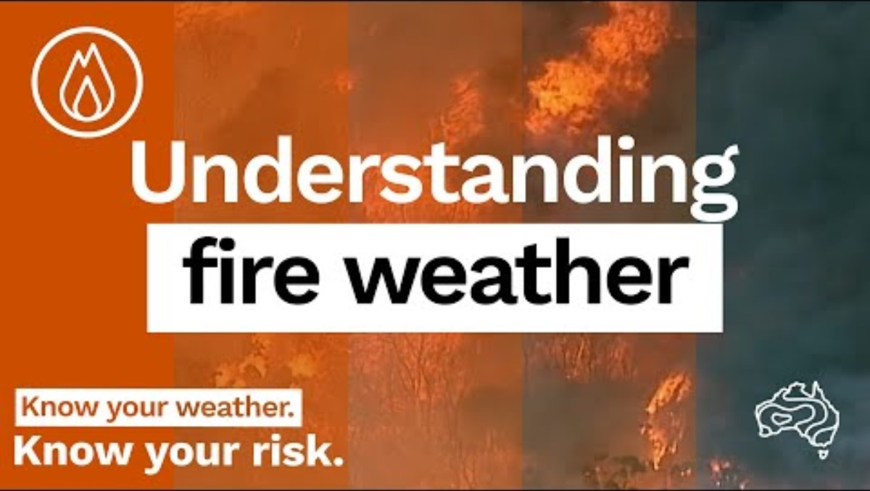
Notes:
Tell the students that they are going to watch a video about Fire Danger Ratings.
Play the video.
Ask the students: What do the fire danger ratings tell us? (Correct answer: The fire danger ratings tell tell how dangerous a fire will be, IF a fire starts)
NB: This is an opportunity to understand students’ conceptions of the fire danger ratings. Listen carefully for misconceptions e.g. The FDR tells us that a fire has started; The FDR tells us that there is going to be a fire.
NB: The video is embedded in the slide. Link to video: https://www.youtube.com/watch?v=aAUbH62VrMI
NB: The students have already watched this video in Module 3: Bushfire Behavior in the Landscape. The purpose of watching it again is to reinforce the key points about weather and to make the connection between weather and Fire Danger Ratings explicit.

Slide 26
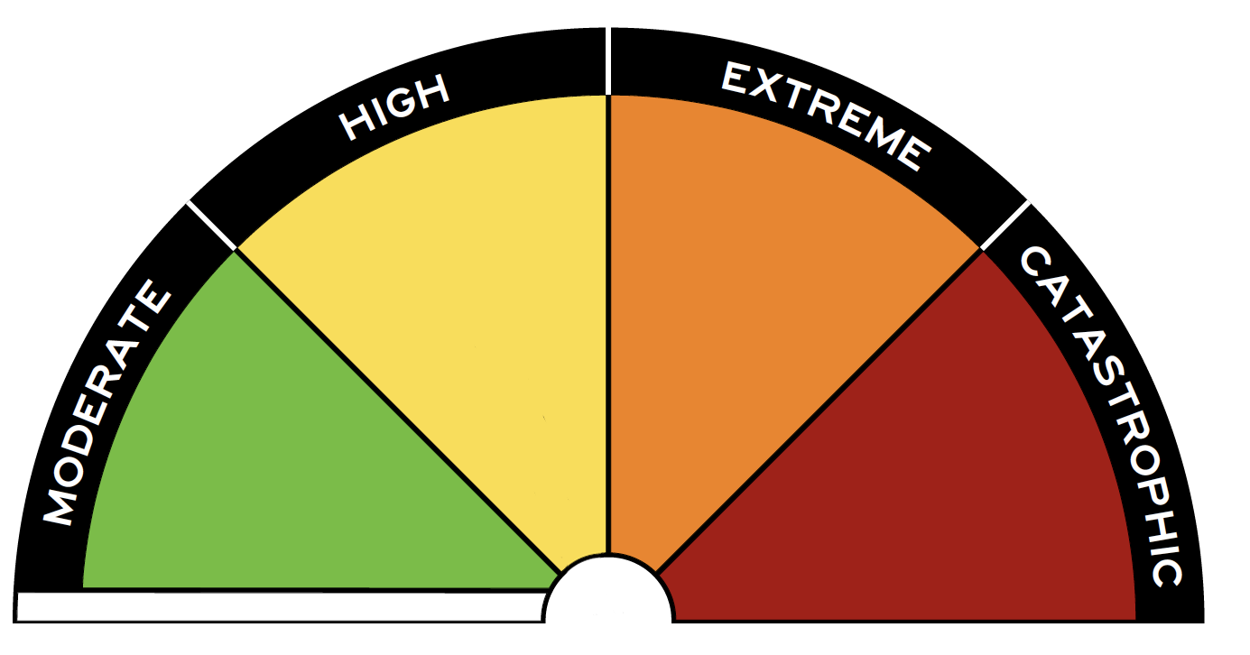
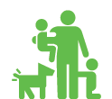

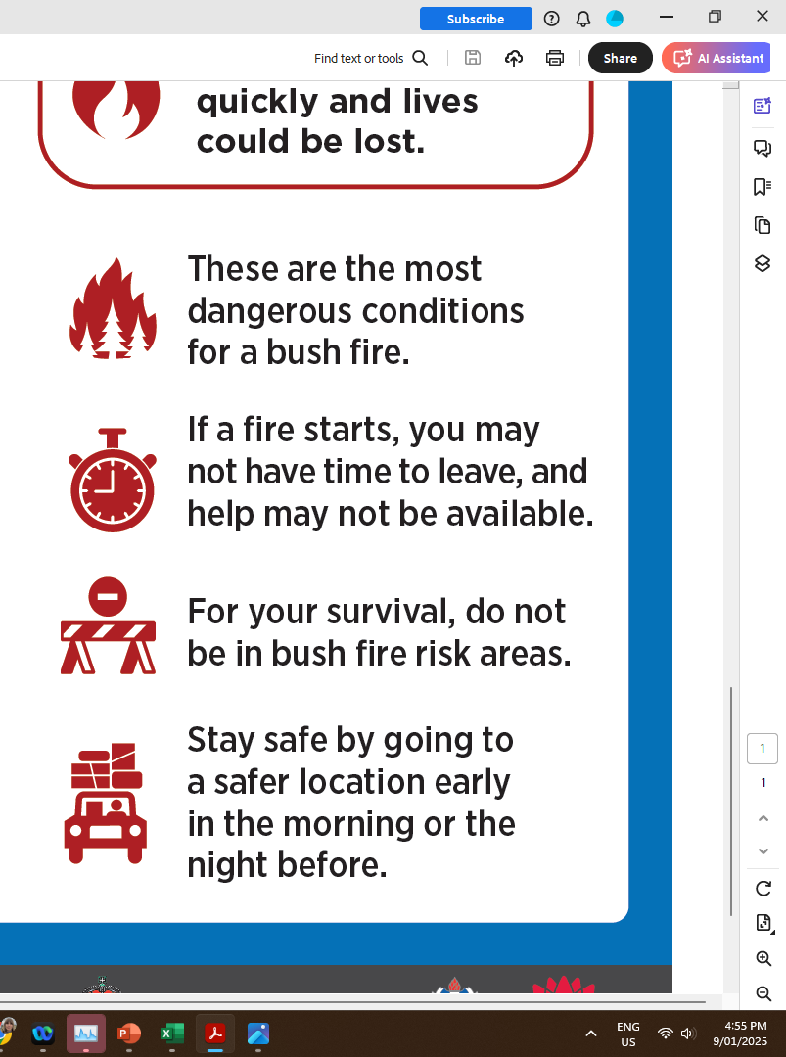


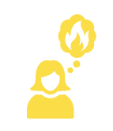
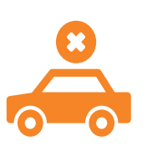
Fire Danger Ratings tell us:
how dangerous a bushfire will be, IF a fire starts
what we need to do to stay safe
NO RATING
MODERATE
HIGH
EXTREME
CATASTROPHIC
It is very unlikely that a dangerous bushfire will occur.
If a bushfire starts, it can probably be controlled.
If a bushfire starts, it could spread and it might be dangerous.
If a bushfire starts, it will spread quickly and it will be dangerous.
If a bushfire starts, it will spread very quickly and it will be extremely dangerous.
NO ACTION REQUIRED.
PLAN AND PREPARE.
BE READY TO ACT.
TAKE ACTION NOW TO PROTECT LIFE AND PROPERTY.
FOR YOUR SURVIVAL, LEAVE BUSHFIRE RISK AREAS.
Make a bushfire plan with your family.
Decide what you will do if there is a fire and be ready to act.
Check your bushfire
plan and make sure your property is prepared.
If a bushfire starts, you may not have time to leave.
Leave bushfire risk areas early in the morning or the night before.
Prepare your property for bushfire.
Be alert for bushfires in your area.
Avoiding bushfire risk areas is your safest option.
Notes:
Facilitate a discussion about the Fire Danger Ratings to familiarise the students with each level of rating. It is important to repeatedly emphasise that these ratings tell us how dangerous fire will be IF a fire starts. It does not tell us if there is going to be a fire and it does not tell us is a fire has started. The students will have already studied the influence of weather of fire behaviour in the previous module, so they will have the requisite to make sense of the rating levels, but the relationship between the ratings and the weather conditions will need to be reinforced.
Suggested discussion prompts:
NO RATING. When there is no rating, it is very unlikely that a dangerous will occur.
What do you think the weather conditions would be like when there is no rating? Prompt for temperature, rainfall, humidity, wind
What should people do when there is no rating?
MODERATE. If a fire starts it will spread slowly and is unlikely to be dangerous.
What do you think the weather conditions would be like when the fire danger rating is MODERATE? Prompt for temperature, rainfall, humidity, wind.
What should people do when the fire danger rating is MODERATE?
HIGH. If a fire starts it could spread and it might be dangerous.
What do you think the weather conditions would be like when the fire danger rating is HIGH? Prompt for temperature, rainfall, humidity, wind.
What should people do when the fire danger rating is HIGH?
EXTREME. If a bushfire starts, it will spread quickly and it will be dangerous.
What do you think the weather conditions would be like when the fire danger rating is EXTREME? Prompt for temperature, rainfall, humidity, wind.
What should people do when the fire danger rating is EXTREME?
CATASTROPHIC If a bushfire starts, it will spread very quickly and it will be extremely dangerous.
What do you think the weather conditions would be like when the fire danger rating is CATASTROPHIC? Prompt for temperature, rainfall, humidity, wind.
What should people do when the fire danger rating is CATASTROPHIC?

Slide 27
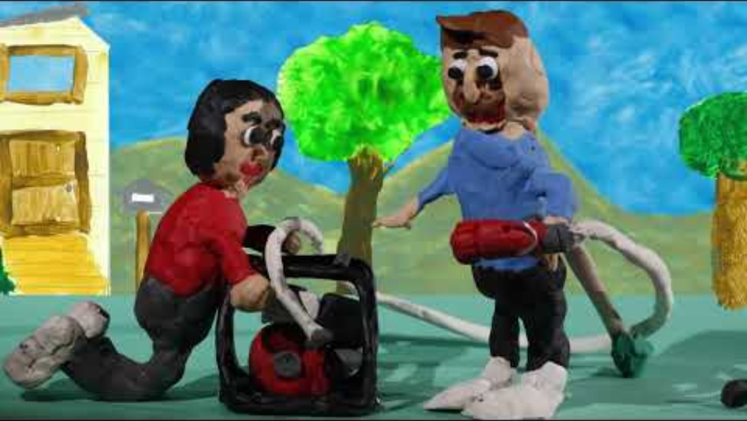
Notes:
NB: The video starts with information about the changes to the Australian Fire Danger Rating that were implemented in 2022. This not required viewing for the students.
Start the video at 01.10.
Before playing the video, tell the students:
In February 2009, the Black Saturday bushfires swept through Strathewen. It caused lot of damage and harm in community. After the fires, the students at Strathewen Primary School wanted to help prevent that damage and harm from happening again in the future, so they made this film to educate their community about how to use the fire danger ratings to stay safe.
Play video.

Slide 28
Do you know how to find out what today’s fire danger rating is?
Notes:
THINK – PAIR – SHARE Do you know how to find out what today’s fire danger rating is?

Slide 29
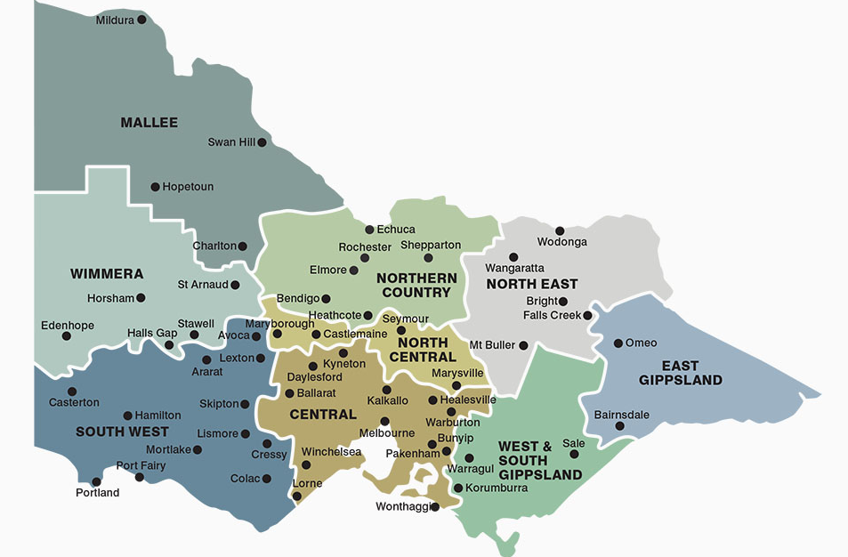
STEP 1: FIND YOUR FIRE WEATHER DISTRICT
Go the CFA website WWW.CFA.VIC.GOV.AU
Click on Warnings and Restrictions
Click on Find your fire weather district
Which fire weather district are we in?
Notes:
Walk the students through the instructions on the slide.
When you get to the map that is displayed on the slide, ask the students: Which fire weather district are we in?

Slide 30
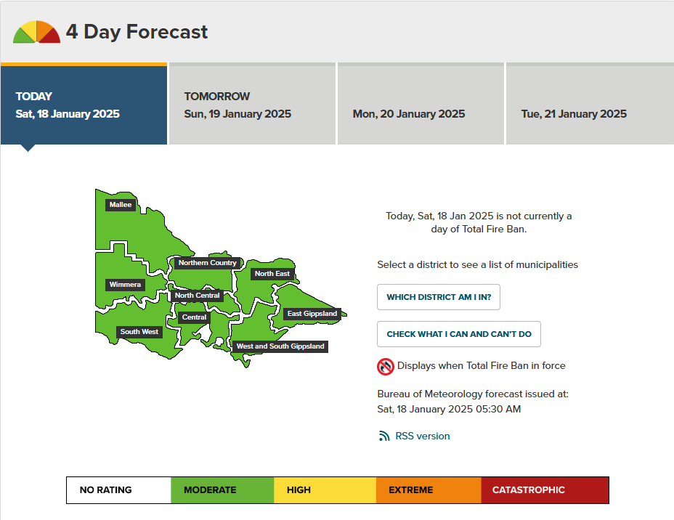

STEP 2: FIND OUR FIRE DANGER RATING
Click on Warnings and Restrictions
Click on Fire Bans, Ratings and Restrictions
Click on Total Fire Bans and Fire Danger Ratings
TODAY’S FIRE DANGER RATING
What fire danger district are we in?
What are the fire danger ratings for our district today?
If a bushfire started in our district today, how dangerous would it be?
Is there anything people should do to stay safe today?
Notes:
Walk the students through the instructions on the slide.
Students can then respond to the questions about today’s fire danger rating in their learning journal.

Slide 31
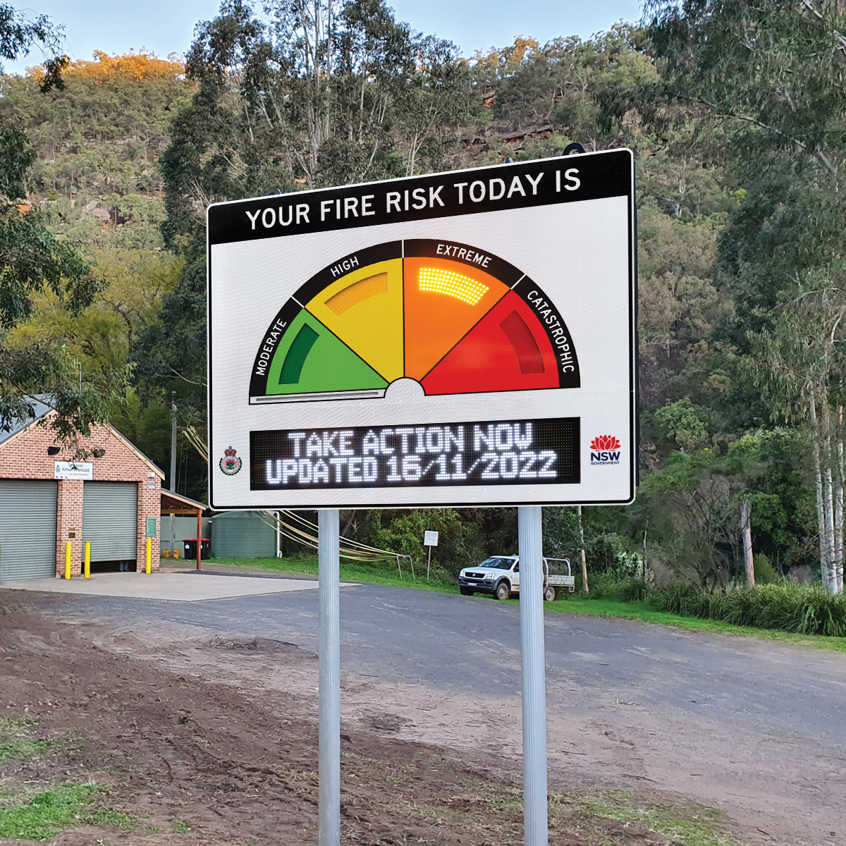
Do you think everyone in our community knows how to
use the Fire Danger Rating System?
Notes:
Ask the students to discuss the question in their groups: Do you think everyone in our community understands how to use the Fire Danger Rating System? Encourage the students to explain their thinking to their fellow group members.
Ask each group to nominate a spokesperson to share their groups response to the question.
Ask the whole class: Is this a problem? Why/Why not?

Slide 32
TEAM CHALLENGE
The bushfire season is approaching. The local CFA is concerned that some people in our community don’t understand the Fire Danger Rating System.
How can we make sure that everyone in our community understands the Australian Fire Danger Rating System?
Your team has 3 minutes to come up one great idea that makes the most of your knowledge, skills and resources!
Image: Kealey, Harkaway Primary School, Class of 2021.
Notes:
Organise the students in teams of 4 or 5.
Introduce the problem: The bushfire season is approaching. The local CFA is concerned that some people in our community don’t understand the bushfire warnings systems.
Ask the students “Why is this a problem?”
Present the question: “How can we make sure that everyone in our community understands the Australian Fire Danger Rating System?”
Give the students three minutes to come up with one great idea that makes the most of their knowledge, strengths, skills and resources. A spokesperson from each group can then share their idea with the class.
The students can then record the problem, the ‘How can we…?’ question and their idea in their learning journal.

Slide 33
Part 5
BUSHFIRE WARNINGS

Slide 34
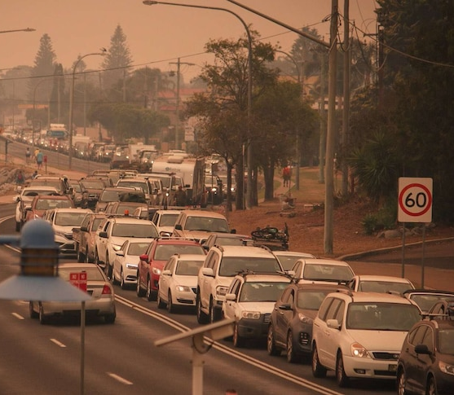
THE PROBLEM
People don’t tune in to bushfire warnings during bushfire season.
When people don’t tune in to bushfire warnings, they don’t find out there is bushfire until it is impacting on their local area. This makes evacuating very dangerous.
Smoke from the fire can make it difficult to see and this increases the chance of car accidents.
Roads can be blocked by fallen trees or debris and cars can’t get through.
Large numbers of people evacuating at the last minute can cause traffic jams.
What do we know about bushfire warnings?
Notes:
Present the problem: People don’t tune in to bushfire warnings during bushfire season.
Talk through the information in the yellow box on the slide.
Facilitate a discussion to capture what the students already know about bushfire warnings. Suggested prompt: What do we know about bushfire warnings?

Slide 35
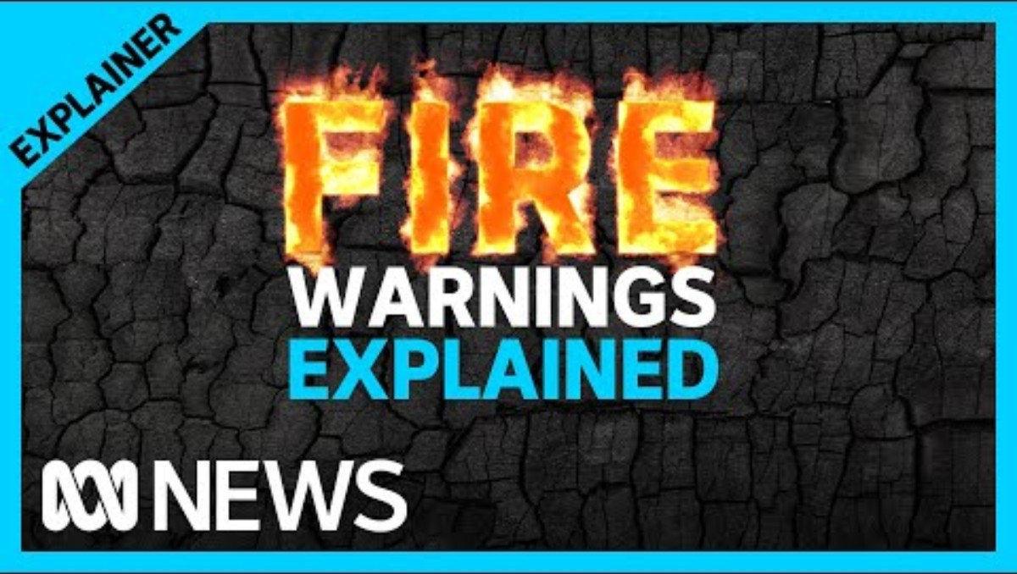
Notes:
Tell the students they are going to watch a video about bushfire warnings.
Play the video.
Facilitate a discussion about the bushfire warnings. Suggested prompts:
What should people do if they receive an ‘Advice’ warning? Stay informed in case things change. If there’s smoke in the air stay inside, close doors and windows, and keep any medication handy
What should people do if they receive a ‘Watch and Act’ warning? Follow your bushfire survival plan, prepare to leave, keep paying attention to warnings
What should people do if they receive an ‘Emergency’ warning”? You need to take life saving action. Leave immediately or if that’s not safe seek shelter straight away.
What are the three levels of warnings? Answer: Advice, Watch and Act; Emergency
Facilitate a short discussion to reinforce the difference between bushfire warnings and the FDRs: i.e. Bushfire warnings tell us that a fire has started. FDRs tell us how dangerous a fire will be, IF a fire starts.

Slide 36

BUSHFIRE WARNINGS
ADVICE
WATCH AND ACT
EMERGENCY WARNING
There is a bushfire in the area.
Seek more information and monitor the situation.
A bushfire emergency is developing in the area.
You need to take action now to protect yourself and others.
There is a bushfire emergency in the area.
You are in danger
You will be impacted.
How do we make sure we get these warnings?
Notes:
Review what each warning level means using the information on the slide.
THINK-PAIR-SHARE: How do we make sure we get these warnings?

Slide 37





There a many different ways to get
bushfire warnings…
VicEmergency hotline
Online
Call 1800 226 226 for up-to-date information
Look on the VicEmergency website.
On your smartphone
Television
Download the VicEmergency app on your smartphone
Watch ABC News 24 or Sky News.
Important message from the CFA!
You should never wait to receive an official warning before you take action. Bushfires can start and travel quickly, so pay attention to your environment. If you see any signs of bushfire activity, such as smoke and flames, tell an adult straight away.
Radio
Tune into ABC local radio
Notes:
Talk through the information on the slide.
Emphasise the point in the green box: You should never wait to receive an official bushfire warning before you take action. Bushfires can start and travel quickly, so pay attention to your environment. If you see any signs of bushfire activity, such as smoke and flames, tell an adult straight away.

Slide 38
Do you think everyone in our community tunes in to bushfire warnings during the bushfire season?
Notes:
Ask the students to discuss the question in groups: Do you think everyone in our community understands how to use the Fire Danger Rating System? Encourage the students to explain their thinking to their other group members.
Ask each group to nominate a spokesperson to share their groups response to the question.
Ask the whole class: Is this a problem? Why/Why not?

Slide 39
TEAM CHALLENGE
The bushfire season is approaching. The local CFA is concerned that some people in our community are not tuning in to bushfire warnings during the bushfire season.
How can we make sure that everyone in our community tunes in to bushfire warnings during the bushfire season?
Your team has 3 minutes to come up one great idea that makes the most of your knowledge, skills and resources!
Image: Kealey, Harkaway Primary School, Class of 2021.
Notes:
Organise the students in teams of 4 or 5.
Introduce the problem: The bushfire season is approaching. The local CFA is concerned that some people in our community are not tuning in to bushfire warnings during the bushfire season.
Ask the students “Why is this a problem?”
Present the question: “How can we make sure that everyone in our community tunes in to bushfire warnings during the bushfire season?”
Give the students three minutes to come up with one great idea that makes the most of their knowledge, strengths, skills and resources. A spokesperson from each group can then share their idea with the class.
The students can then record the problem, the ‘How can we…?’ question and their idea in their learning journal.

Slide 40
Part 6
BUSHFIRE PLANS

Slide 41
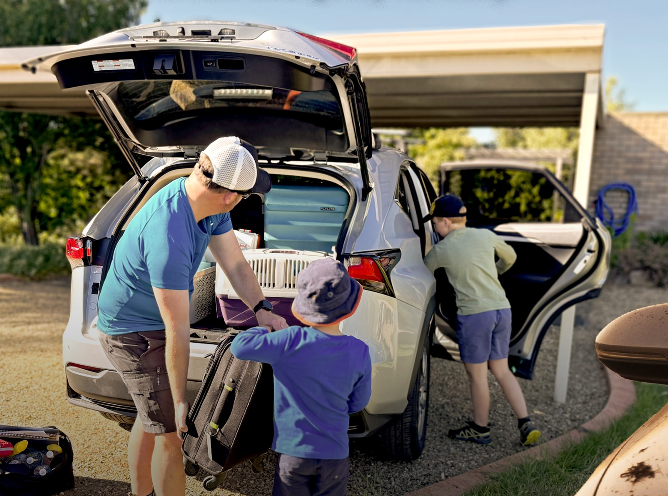
THE PROBLEM
People don’t make detailed bushfire survival plans.
People often decide that if there is a bushfire they will evacuate, but they don’t always think about the details. Bushfire emergencies can be very stressful and without a detailed plan, people are forced to make last minute decisions which can put them in very dangerous situations.
Why don’t people make detailed
bushfire survival plans?
Notes:
Present the problem: People don’t make detailed bushfire survival plans.
Talk through the information in the yellow box on the slide.
Put the students into groups of four. Give them a few minutes to discuss the question: Why don’t people make detailed bushfire survival plans?
Ask the groups to nominate a spokesperson. Ask the spokesperson from each group to share their groups ideas with the class.

Slide 42
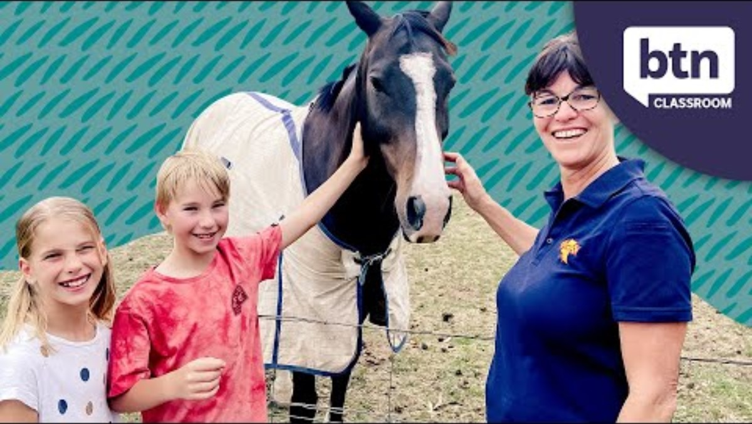
Notes:
Watch the video.
Facilitate a discussion about the video. Suggested prompt:
What do people need to think about when they are making a bushfire plan?
ADDITIONAL VIDEOS ABOUT BUSHFIRE PLANS
Decision making (Country Fire Authority) https://www.youtube.com/watch?v=YcNRHBykCXg&t=1s NB: This video includes the old fire danger rating system.
Preparing for bushfires (Country Fire Authority) https://www.youtube.com/watch?v=bJO75JPDlBk&list=PL6EHXr54f5MoBfmOe0cYagHhPRNDjzzNL&index=12

Slide 43
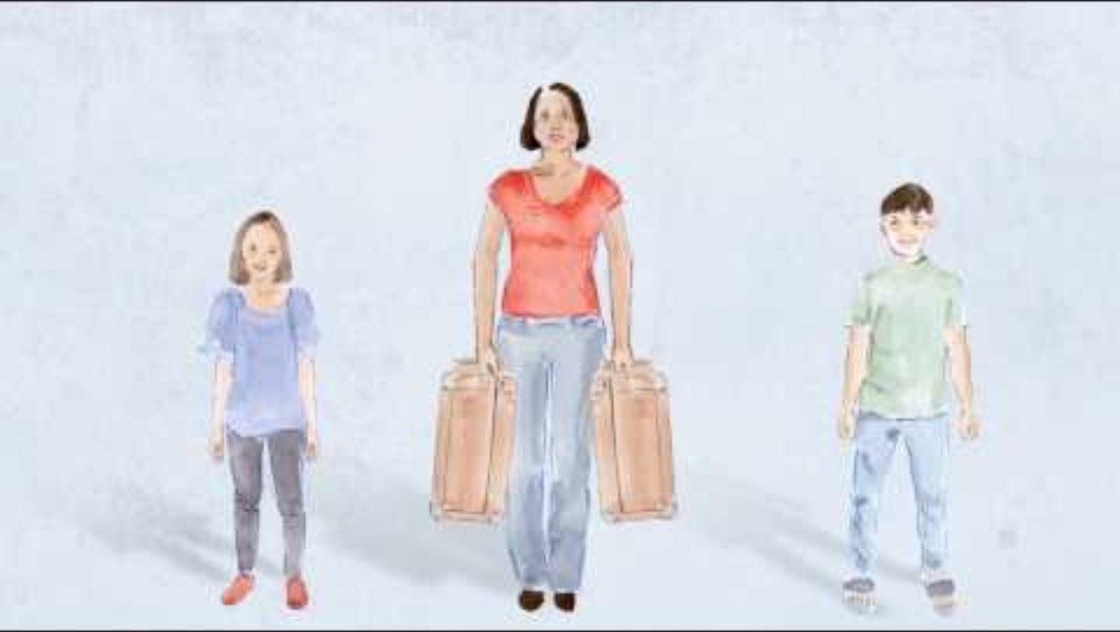
Notes:
Tell the students: This video form the CFA lists everything a detailed bushfire survival plan needs to include. Note down as many things as you can!
After the video, ask the students to share some of the things they noted down.
NB: This video was made before the new fire danger rating system was introduced and it shows the old ratings. The students may notice this and if they do you can explain that the system was changed to make it easier for people to understand.

Slide 44
Do you think everyone in our community has made a detailed bushfire plan?
Notes:
Ask the students to discuss the question in groups: Do you think everyone in our community has made a detailed bushfire plan? Encourage the students to explain their thinking to their other group members.
Ask each group to nominate a spokesperson to share their groups response to the question.
Ask the whole class: Is this a problem? Why/Why not?

Slide 45
TEAM CHALLENGE
The bushfire season is approaching. The local CFA is concerned that a lot of people in our community don’t have a detailed bushfire plan.
How can we make sure that everyone in our community makes a detailed bushfire plan before bushfire season starts?
Your team has 3 minutes to come up with one great idea that makes the most of your knowledge, skills and resources!
Image: Kealey, Harkaway Primary School, Class of 2021.
Notes:
Organise the students in teams of 4 or 5.
Introduce the problem: The bushfire season is approaching. The local CFA is concerned that a lot of people in our community don’t have a detailed bushfire plan.
Ask the students “Why is this a problem?”
Present the question: “How can we make sure that everyone in our community makes a detailed bushfire plan before bushfire season starts?”
Give the students three minutes to come up with one great idea that makes the most of their knowledge, strengths, skills and resources. A spokesperson from each group can then share their idea with the class.
The students can then record the problem, the ‘How can we…?’ question and their idea in their learning journal.

Slide 46
END OF MODULE

