Slide 1
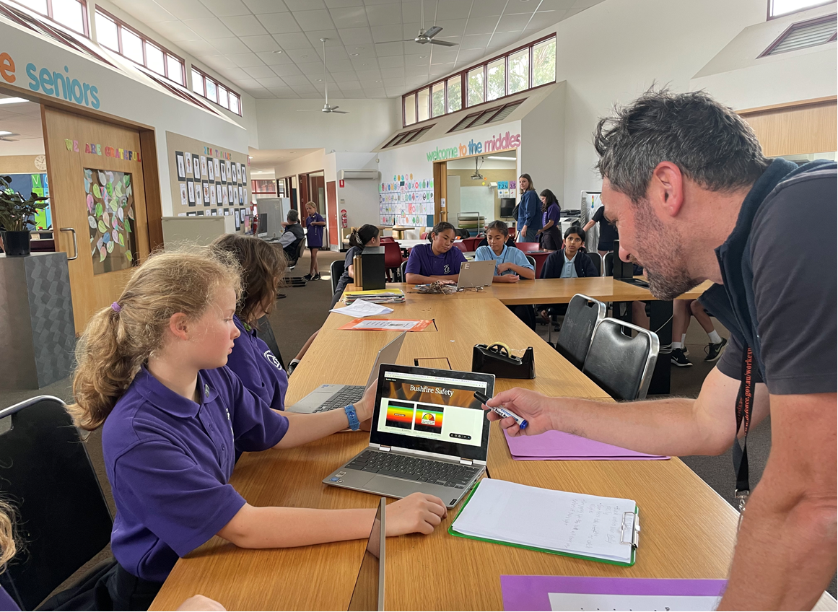
MODULE 1
TUNING IN

Slide 2
PART 1
BUSHFIRE SAFETY

Slide 3

What do the words
bushfire safety
mean to you?
Notes:
Support the class to develop a concept map of bushfire safety. On a large piece of poster paper, write Bushfire Safety at the centre of the page. Encourage the students to contribute any ideas that come to mind when they think about the words ‘bushfire safety’. Add their ideas to a concept map. When there is a good amount of ideas on the concept map, discuss some of the ideas, drawing particular attention to ideas related to prevention, preparedness and response. Finish up this activity by emphasising that bushfire safety is about taking action BEFORE a bushfire occurs, so that communities and the environment won’t be harmed if a bushfire does occur.
NOTE: A standard definition of ‘bushfire safety’ in the Australian emergency management sector is as follows: Bushfire safety refers to the actions people can take to prevent, prepare for, and respond to bushfires, to protect life, property, and the environment.

Slide 4
BUSHFIRE SAFETY
Know
Want to know
Learned
What do you know about bushfire safety?
What do you want to know about bushfire safety?
Notes:
Provide each student with a blank piece of lined paper. Ask them to draw up KWL chart and enter what they know and what they want to know. Invite the students to share some of their ideas. Tell the students to keep their KWL charts in a safe place until the end of the lesson (NB: At the end of the lesson, they can paste their KWL chart into their learning journals).

Slide 5
THINK
EMPATHY
MAP
FEEL
DO
SAY
Notes:
Provide each student with a copy of the empathy map or provide them with a blank piece of unlined paper and instruct them to copy the slide.

Slide 6
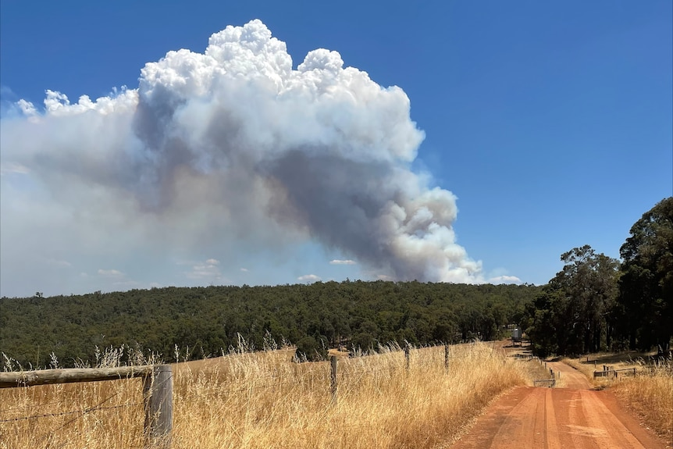
Imagine someone sees this view from their front yard.
What might they think, feel, say and do?
Notes:
Present the slide. Ask the students: If someone saw this view from their front yard, what might they think? What might they say? What might they feel? What might they do? Invite the students to share a few ideas and then ask them to add more ideas to their empathy map. Students can discuss their ideas in pairs and record responses on their own empathy map.
NOTE: For this activity you may wish to use another image that more closely resembles the geographical context in your local area. You can find some other photos at the end of this slide and you can also search online for one yourself.
This activity is intended as a gentle introduction to human responses in a bushfire emergency and it is recommended that the photo you use depicts bushfire smoke rising up into the sky as opposed to an image with flames and/or extreme bushfire behaviour.

Slide 7
Does this have anything to do with us?
Notes:
Facilitate a class discussion about whether any of this is relevant to them.
First, ask the students “Are bushfires something WE need to think about in OUR community? Why or why not?” Encourage the students to share their thoughts with other each in small groups for a few minutes and then invite them to feed back to the main group.
Second, ask the students “How important is bushfire safety in our community?” Encourage the students to share their thoughts with other each in small groups for a few minutes and then invite them to feed back to the main group.

Slide 8
PART 2
OUR ROLE IN BUSHFIRE SAFETY

Slide 9
The Victorian Government says that ALL Victorians need to play a role in bushfire safety to help protect themselves and their community from the impacts of a bushfire event.
Do you think everyone in our community is playing a role in bushfire safety?
Do you think the children in our community are playing a role in bushfire safety?
Notes:
Read out the statement on the slide.
Ask the students, “Do you think everyone in our community is playing a role in bushfire safety?” Facilitate a discussion about the benefits of everyone playing a role in bushfire safety. Discussion prompt:
Would it be a good thing for everyone in our community to play a role in bushfire safety? Why/Why not? NOTE: When having this discussion, highlight that in a bushfire emergency, the local fire brigade cannot send a fire truck to protect every family and every house (e.g. ask the students how many fire trucks the brigade has and how many houses there are in the local community). Emphasise that the local brigade need the local people to do their bit to keep themselves and others safe.
Ask the students, “Do you think the children in our community are playing a role in bushfire safety?” Facilitate a discussion about the benefits of children playing a role in bushfire safety. Discussion prompt:
Would it be a good thing for everyone in our community to play a role in bushfire safety? Why/Why not? (NOTE: When having this discussion, asl the students to provide any examples where they have already played a role).

Slide 10
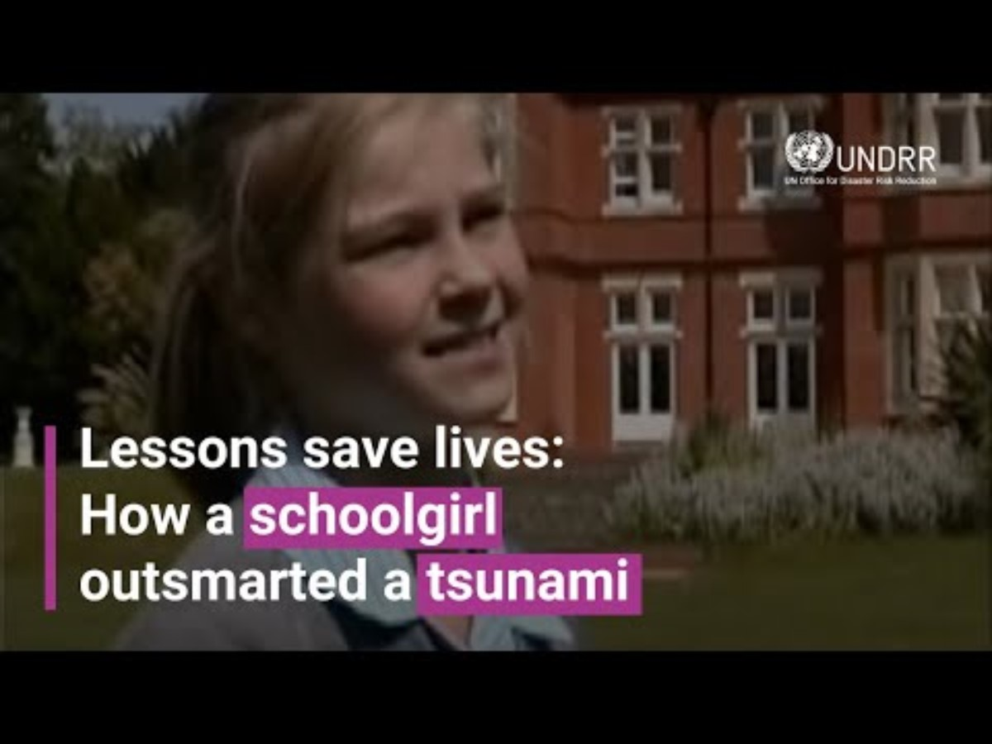
Notes:
Introduce this video about 10 year old Tilly Smith and the decisive action she took to save over 100 people from the Boxing Day tsunami in 2004. Tell the students that while this video is about a tsunami not a bushfire, it illustrates the important role children play in an emergency situation.
Tell the students that after the video there will be Kahoot quiz about Tilly’s experience.
NOTE: The video is embedded in the slide. It can also be accessed via this link https://www.youtube.com/watch?v=V0s2i7Cc7wA

Slide 11
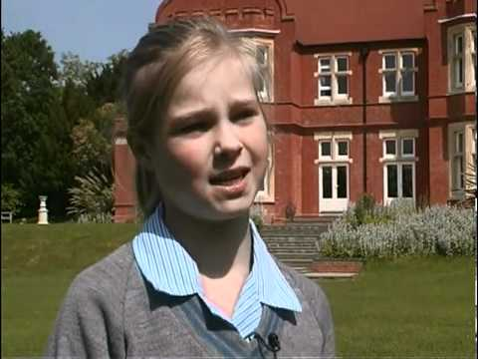

QUIZ TIME!
Notes:
Link to Kahoot Quiz https://create.kahoot.it/details/17e3b856-c687-4750-a2f7-50d576d85145

Slide 12
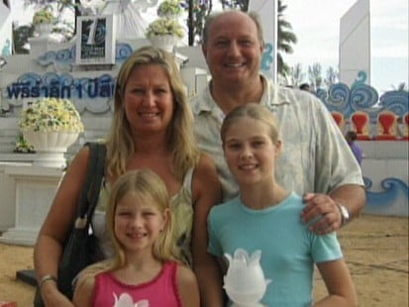
What do you think about Tilly’s story?
Notes:
Facilitate a class discussion about the personal strengths that enabled Tilly to save all those people on the beach. Discussion prompts:
When challenges did Tilly face when she tried to warn her parents that a tsunami was coming? (e.g. her parents didn’t know what she was talking about; her parents weren’t concerned).
How did Tilly respond to these challenges? (e.g. she didn’t give up, she kept on trying to convince her parents that they needed to act, she eventually said “Right, that’s it I’m going!”)
What personal strengths did Tilly demonstrate that day?
Did she demonstrate confidence? (A: Yes, she was very confident that there was a tsunami coming and that everyone needed to get off the beach)
Did she demonstrate persistence? (A: Yes, she kept on trying to convince her parents that they needed to take action)
Did she demonstrate determination? (A: Yes, she did not give up until everyone on the beach had been warned)
Did she demonstrate courage? (A: Yes, in the end, she had to really take a stand and say that she was leaving)

Slide 13

What does Tilly’s story teach us about the role children can play in bushfire safety in our community?
Notes:
Ask the students to discuss the following question in pairs. Give them a couple of minutes and then go around the room, asking each pair to share their thoughts.
Record the key ideas on the board.

Slide 14
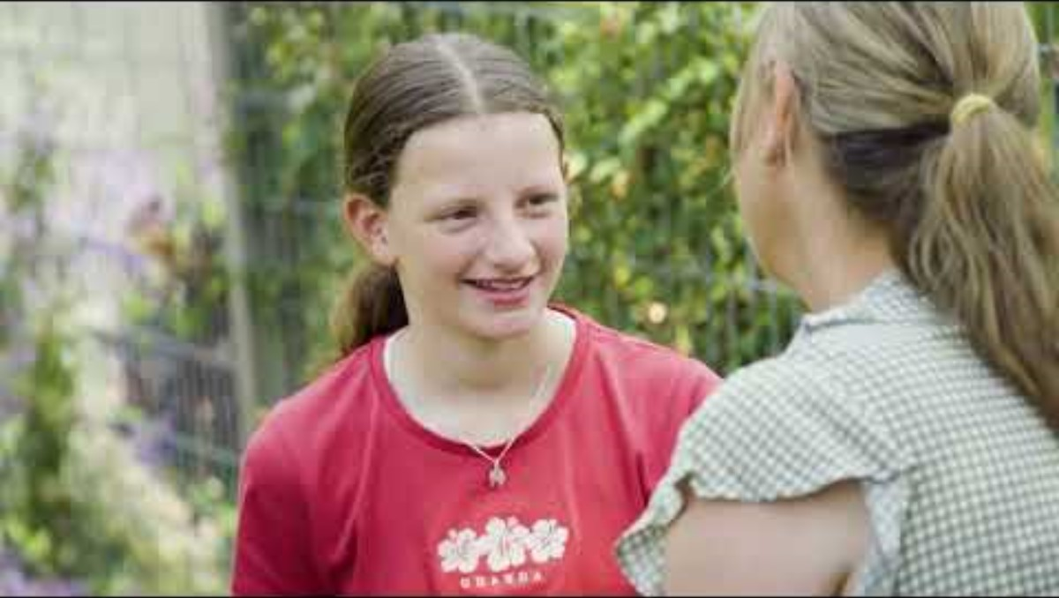
Notes:
Tell the students that this term, they are going to be learning about bushfire safety and taking action to increase bushfire safety in their own community (e.g. “At this school, we believe that you have a really important role to play in bushfire safety, so we are going to be learning more about it and you will be doing a project to help increase bushfire safety in our community”.).
Introduce the video which shows them the kind of learning they are going to be doing. After the video, ask the students if they have any questions about what they saw in the video. If the questions are about specific issues relating to bushfire or bushfire safety that are covered in the Discover modules, tell them to add them to their ‘Want to know’ column of their KWL chart and they will addressed in the next couple of weeks.

Slide 15
PART 3
LEARNING JOURNAL

Slide 16
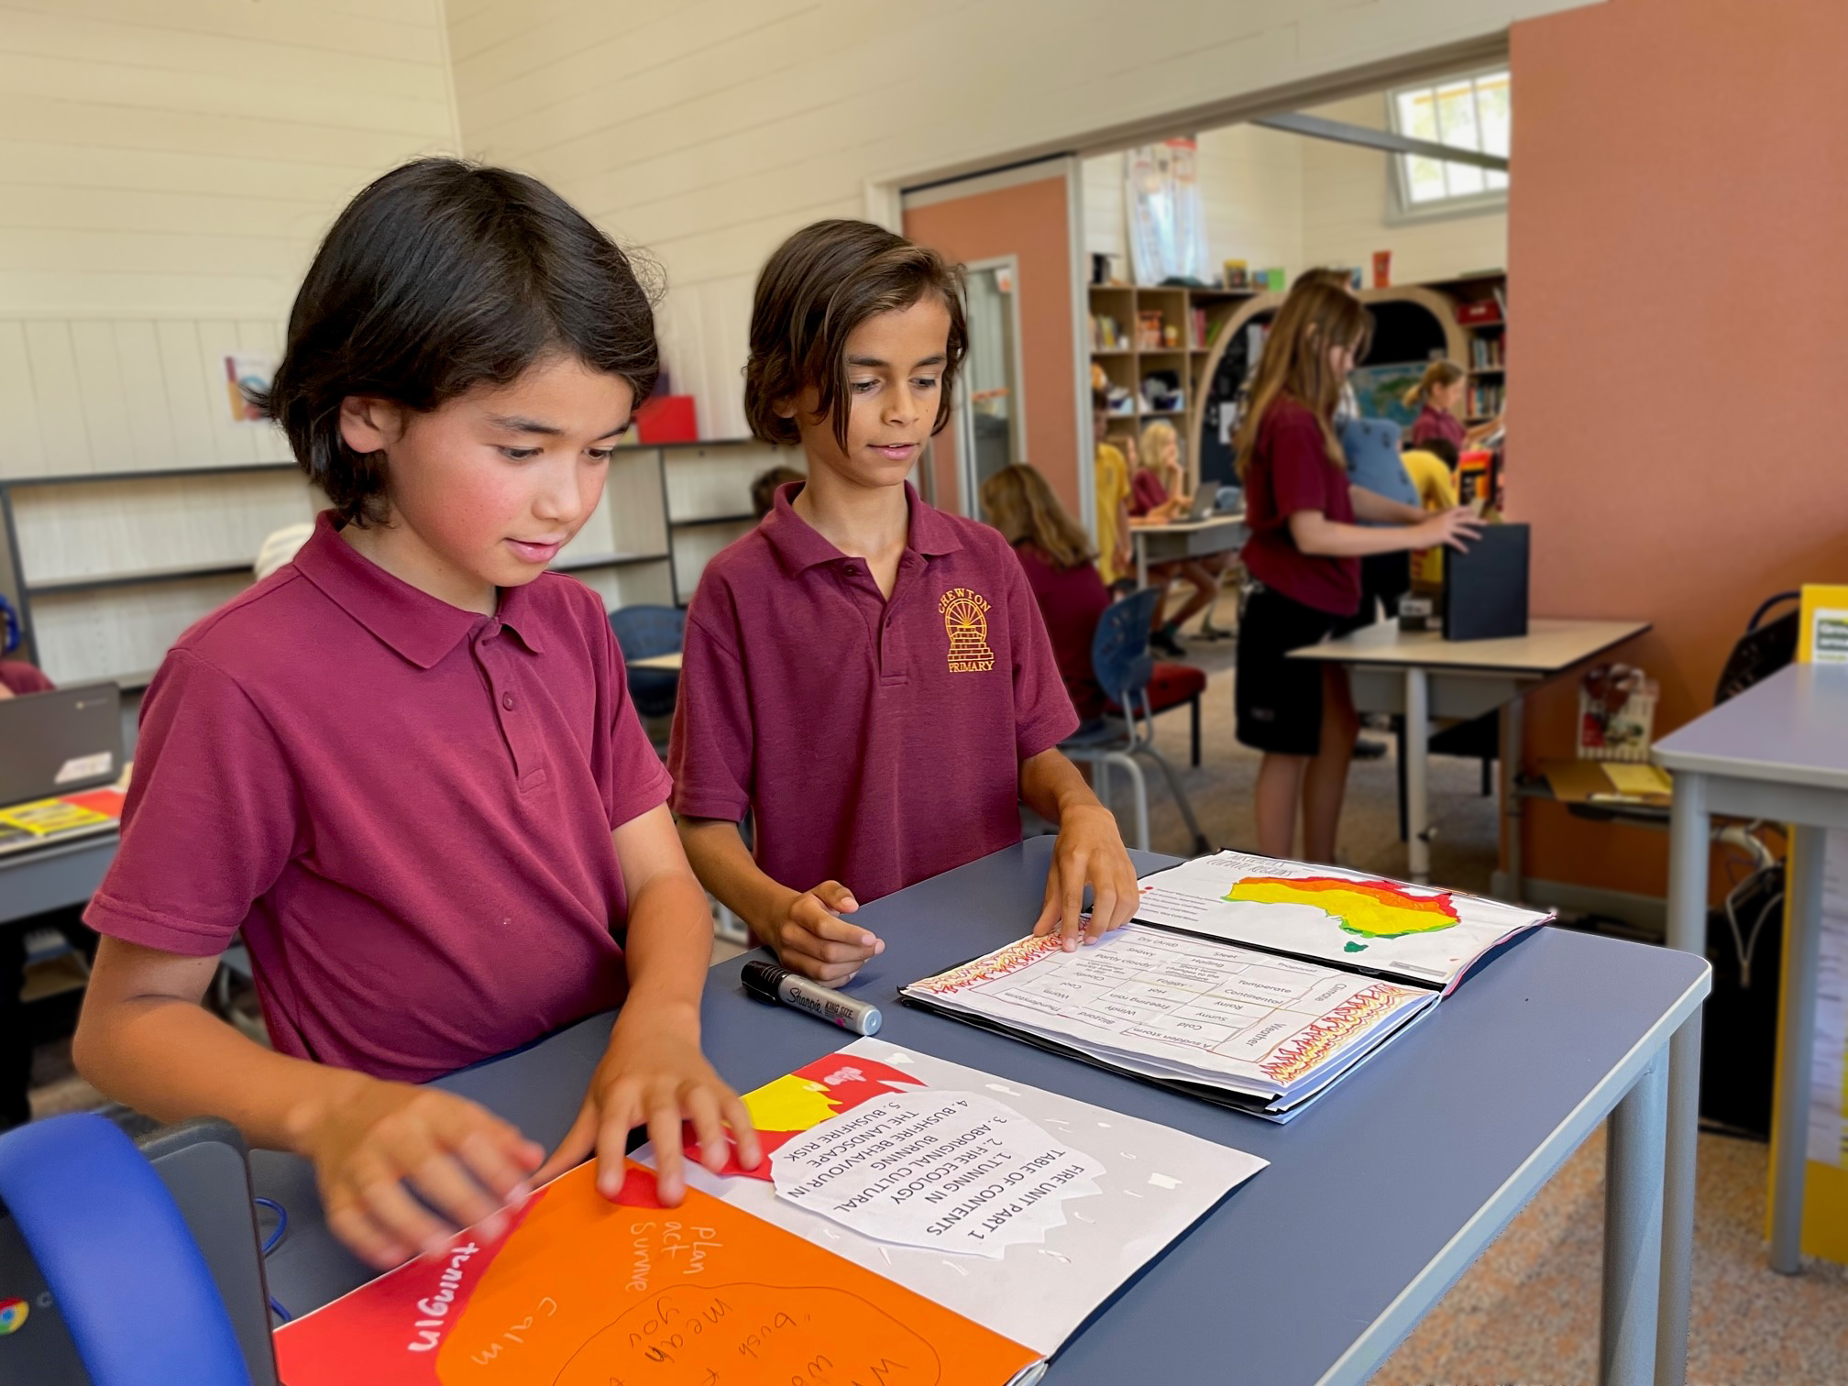


YOUR BUSHFIRE SAFETY JOURNAL
You will use this journal to record your knowledge, thoughts and ideas during the program.
Paste your KWL chart to the inside cover or your learning journal.
Decorate the front cover of your learning journal in your free time.
Students at Chewton Primary School display their learning journals at their Bushfire Safety Showcase.
Notes:
Provide each student with a lined notebook to use as their Bushfire Safety Learning Journal. Tell them that they will be using this journal to record their learning and ideas during the term.
Show the students how to paste their KWL chart inside the front cover of their learning journal.
Encourage the students to decorate the cover of their learning journal in their free time.

Slide 17


YOUR FIRST JOURNAL ENTRY!
Open your learning journal to a new page.
Write the heading ‘Bushfire Safety’
Reflect on what you have learned so far and write them down. You can use the following questions to guide you:
    What is bushfire safety?
    Is it important for children to learn about bushfire safety? Why/Why not?
    Do the children in our community have a role to play in bushfire safety? Why/Why not?
    Do you have any personal strengths, talents or skills that you could use to help increase bushfire safety in our community?
Notes:
Allow the students some time to write the first entry in in their learning journal under the heading “Our Role in Bushfire Safety”.
REFLECTIVE WRITING - WOULD BE GREAT FOR THEM TO REVISIT THIS AT THE END OF THE PROGRAM AND UPDATE IT
IS IT IMPORTANT FOR CHILDREN IN ____________ TO LEARN ABOUT BUSHFIRE SAFETY? WHY/WHY NOT?
DO YOU THINK THE CHILDREN IN OUR COMMUNITY HAVE A ROLE TO PLAY IN BUSHFIRE SAFETY? WHY/WHY NOT?
DO YOU HAVE ANY PERSONAL STRENGTHS, TALENTS OR SKILLS THAT YOU COULD USE TO INCREASE HELP INCREASE BUSHFIRE SAFETY IN OUR COMMUNITY? (CONNECTS TO PERSONAL AND SOCIAL CAPABILITY)
Optional additional questions:
Do you think you play a role in in bushfire safety in our community?
What role could you play?

Slide 18
END OF MODULE

Slide 19
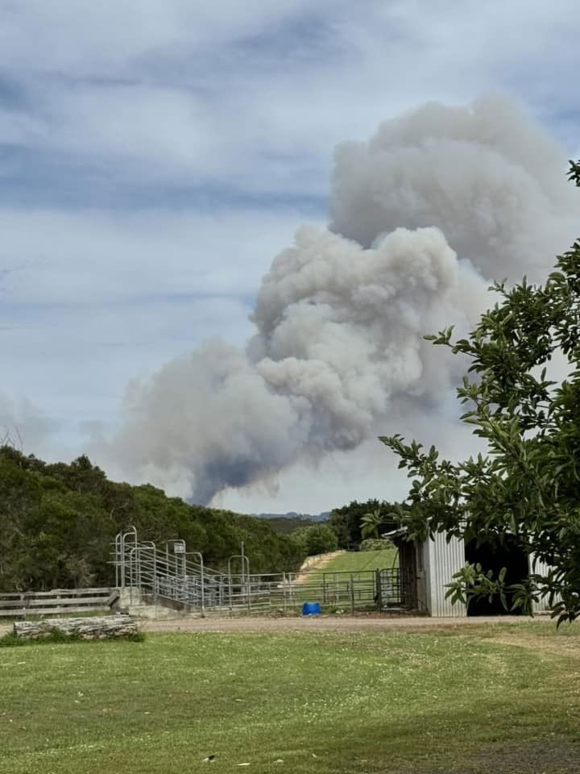
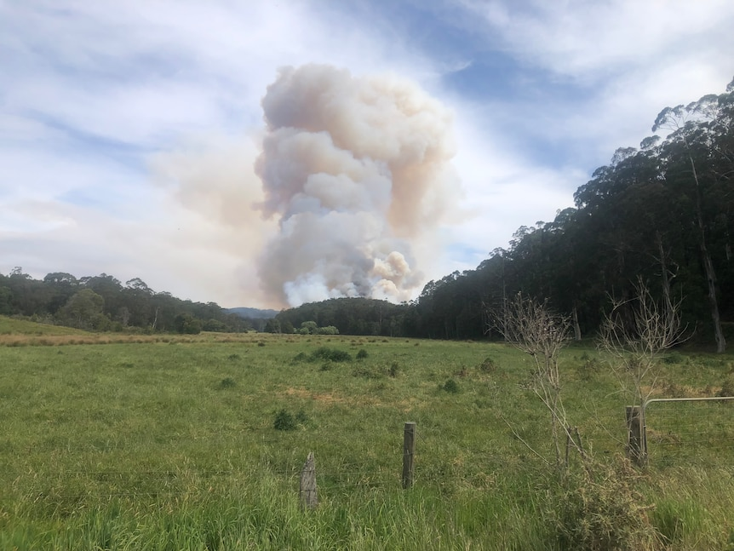
Photo credit: ABC News
Photo credit: ABC News
Notes:
Alternate photos for the empathy mapping activity in Part 1 of this module.

Slide 20
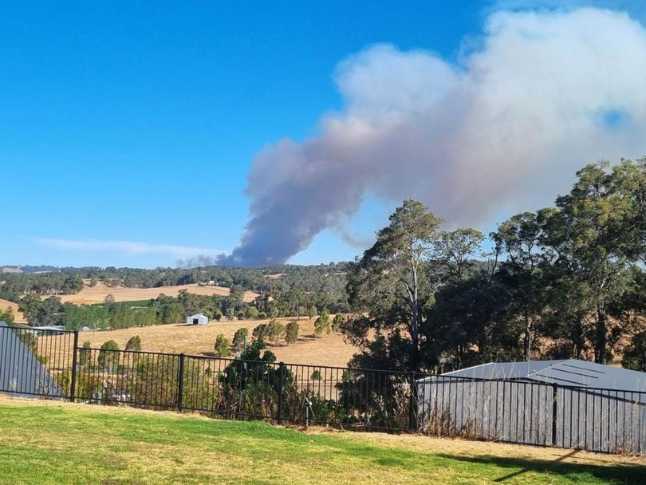
Photo credit: The West Australian
Notes:
Alternate photos for the empathy mapping activity in Part 1 of this module.

